Slide 1
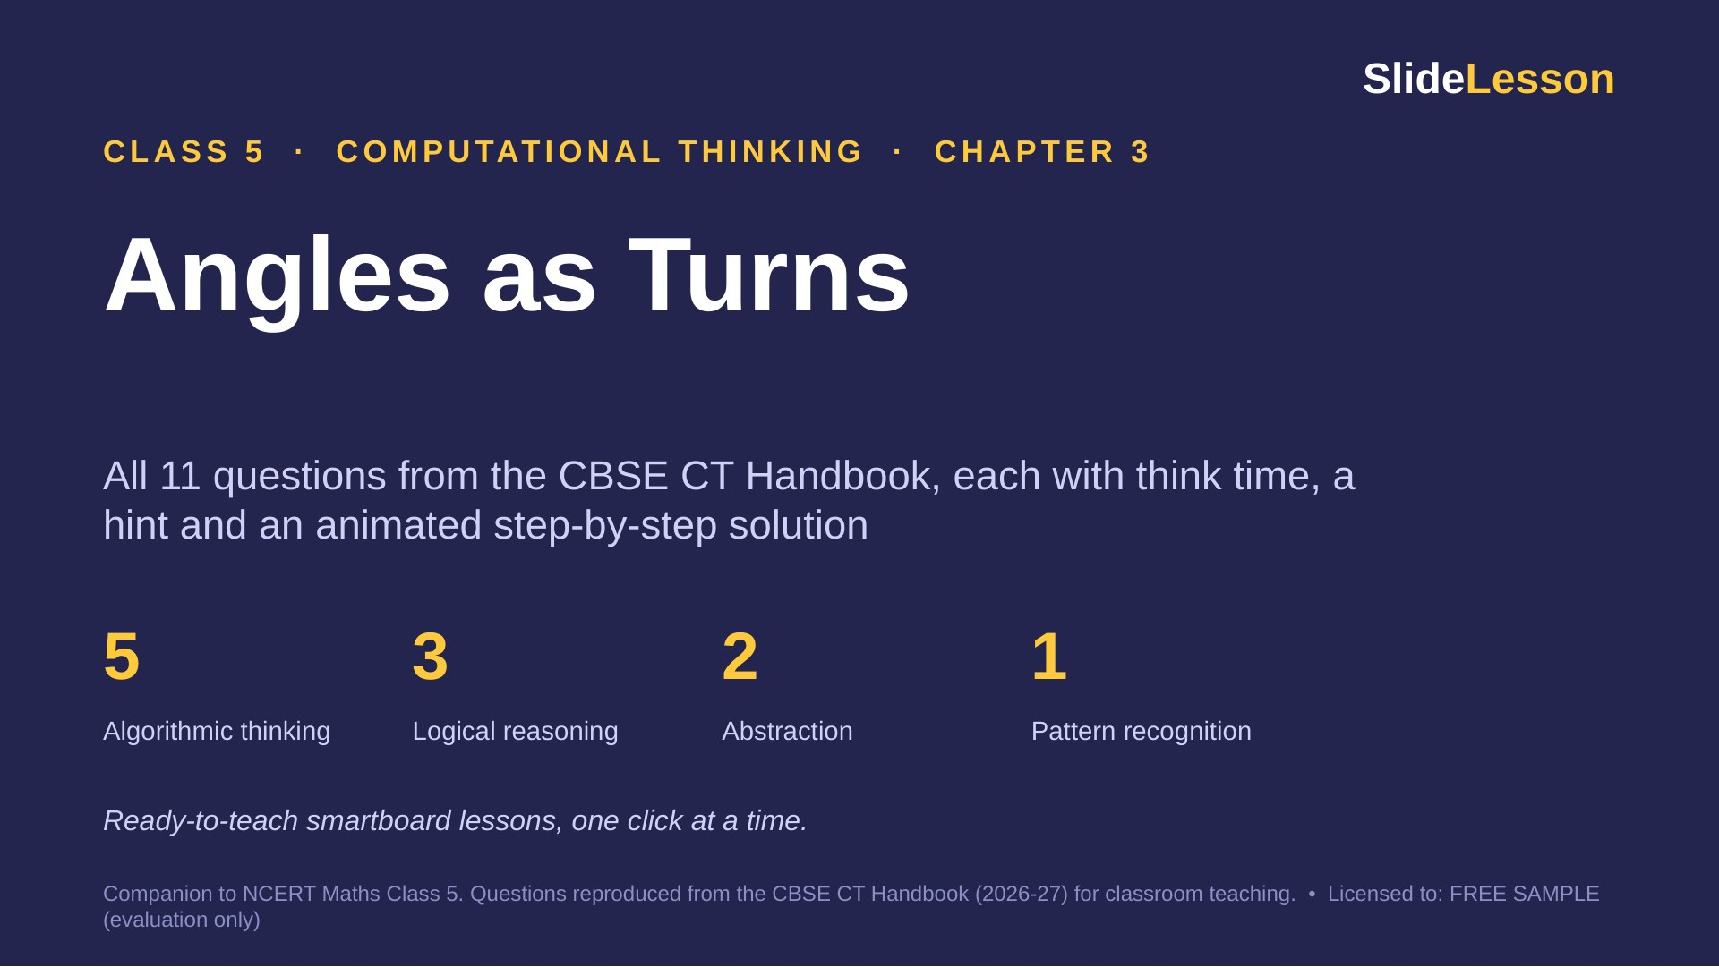
Notes:
This deck covers every question in Chapter 3 of the Class 5 CT Handbook (11 questions and The Thinking Spot). Each question has 3 slides: THINK (60 seconds alone), HINT, and SOLUTION (click to reveal one step at a time). Speaker notes give facilitation tips, common mistakes and extension questions.

Slide 2
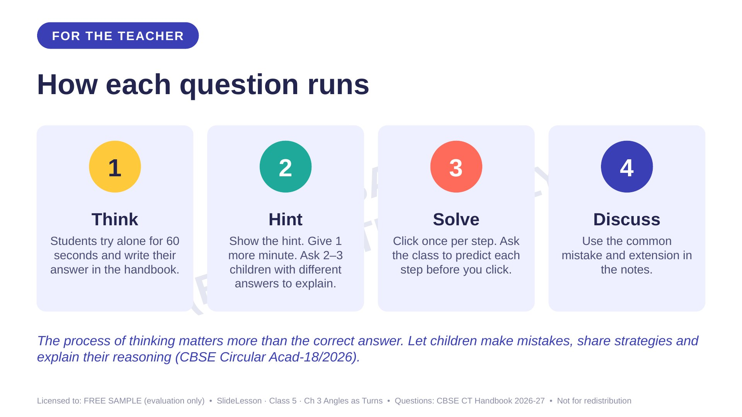

Slide 3
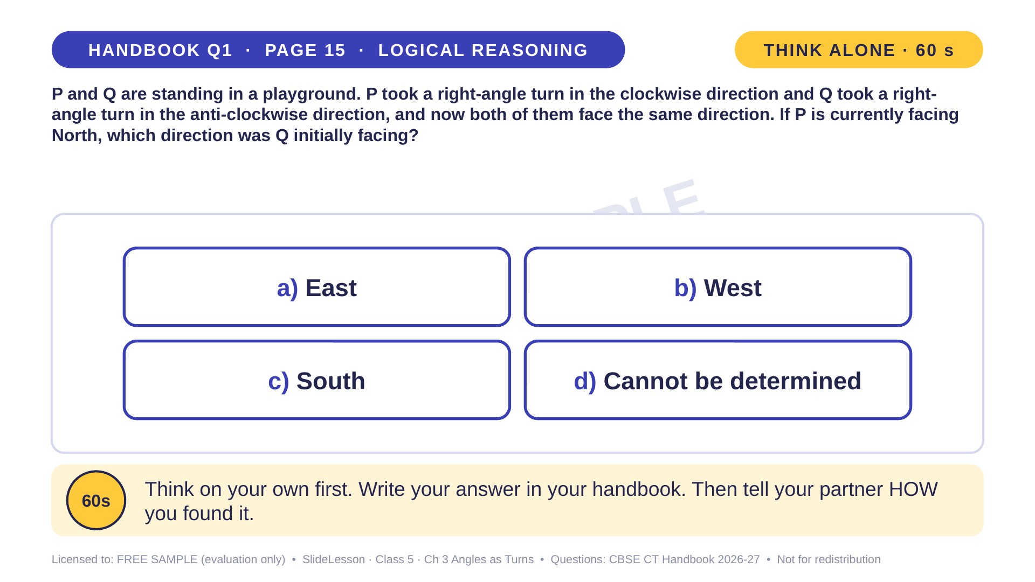
Notes:
WHILE SOLVING: have two children stand, act out the turns and point. COMMON MISTAKE: undoing the turn the wrong way and answering West. EXTENSION: which way was P facing at first? (West)
ANSWER (do not tell yet): a) East

Slide 4
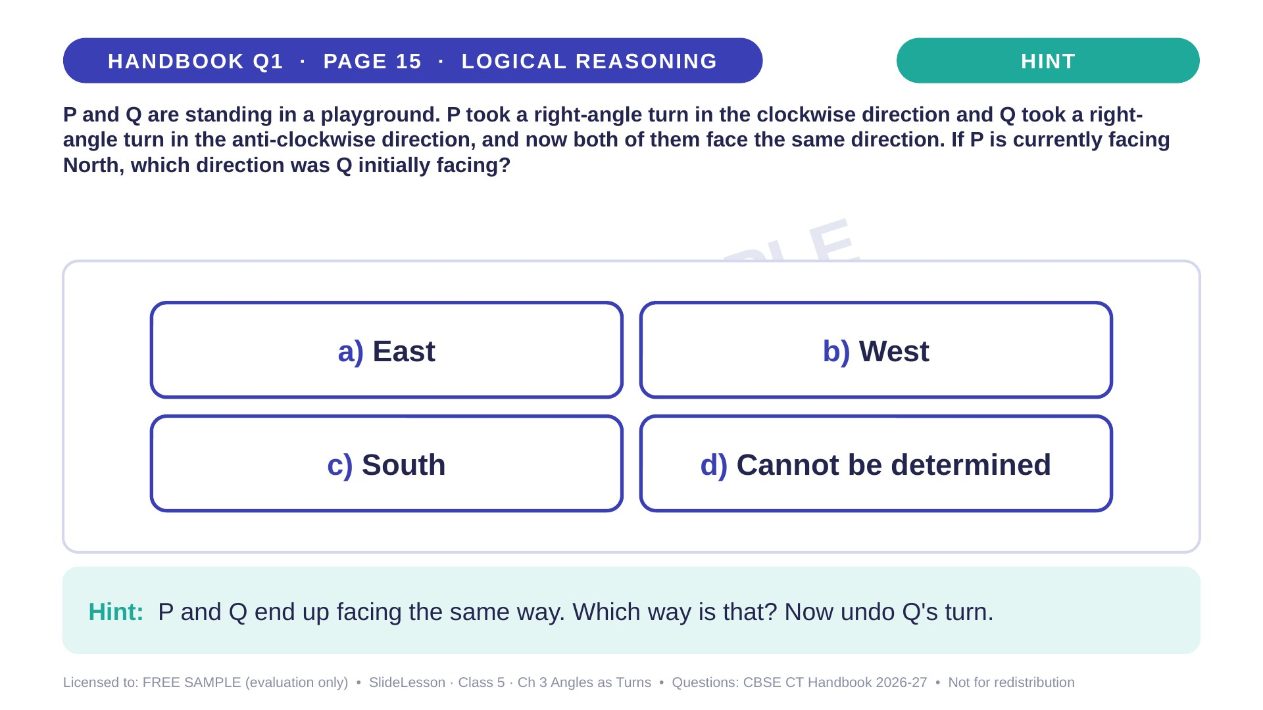
Notes:
Give the hint, then 1 more minute. Ask 2-3 children with DIFFERENT answers to explain their thinking before moving on.
WHILE SOLVING: have two children stand, act out the turns and point. COMMON MISTAKE: undoing the turn the wrong way and answering West. EXTENSION: which way was P facing at first? (West)

Slide 5
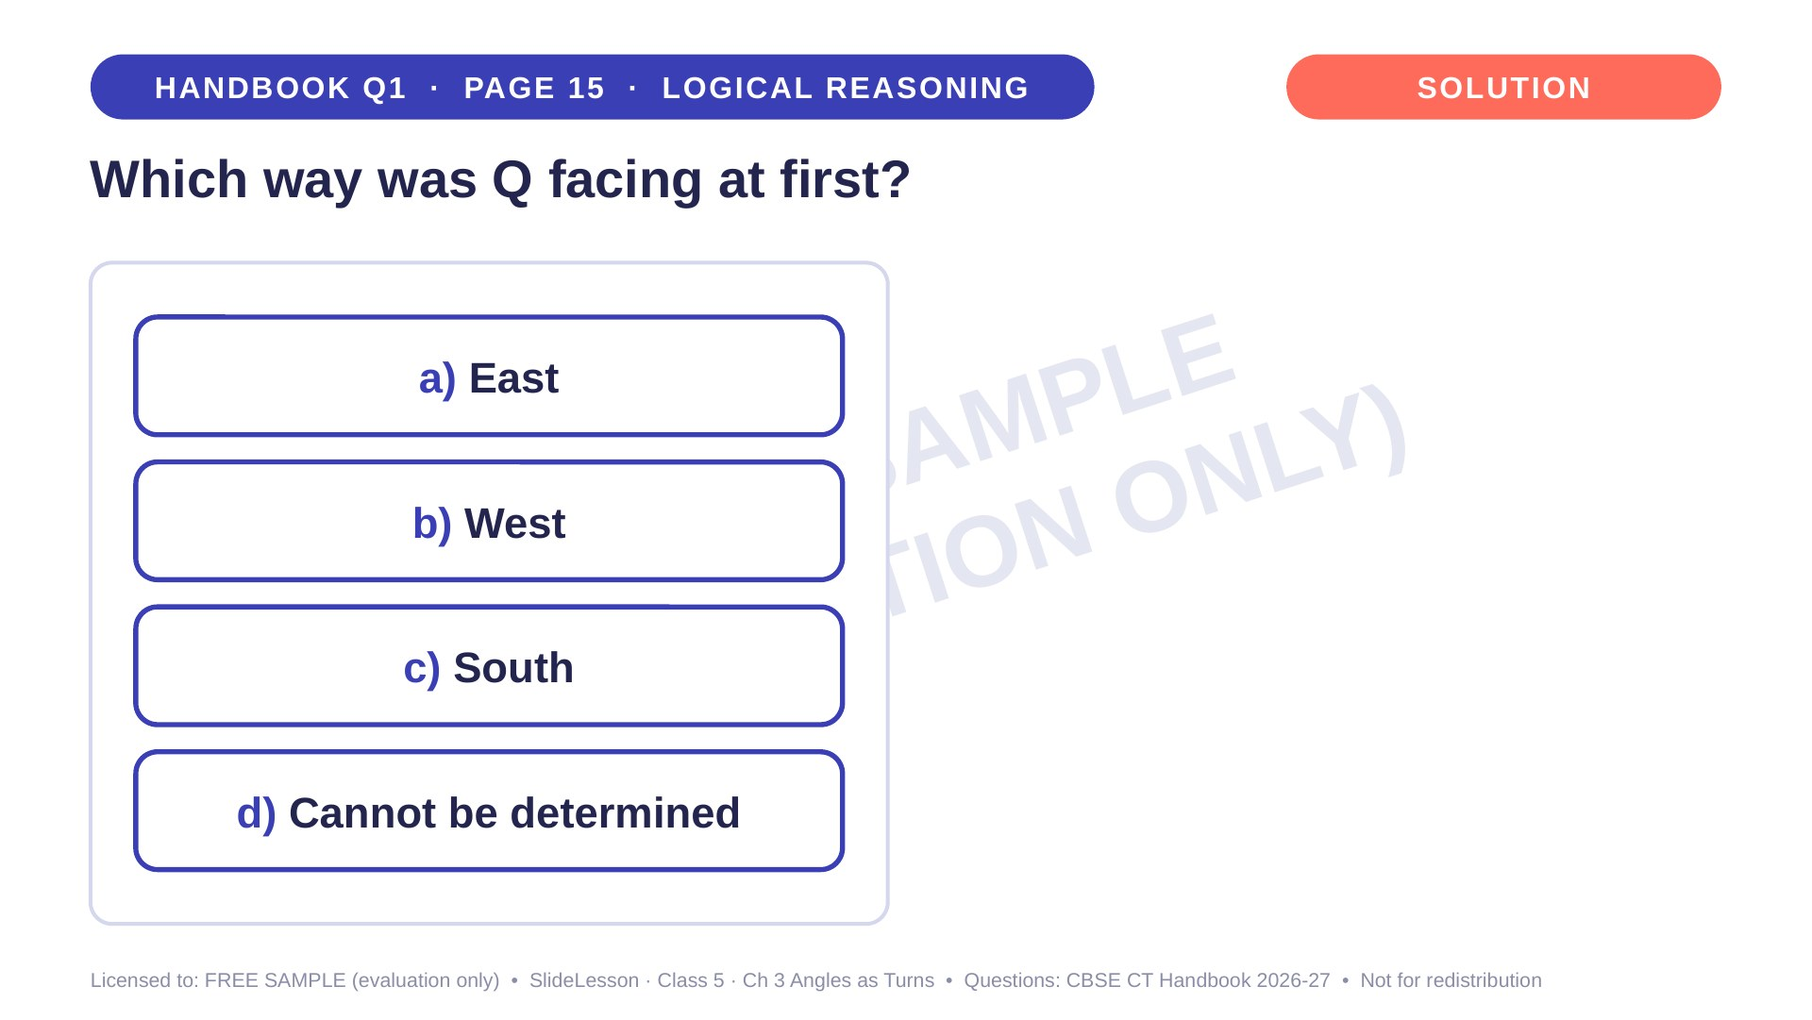
Notes:
WHILE SOLVING: have two children stand, act out the turns and point. COMMON MISTAKE: undoing the turn the wrong way and answering West. EXTENSION: which way was P facing at first? (West)

Slide 6
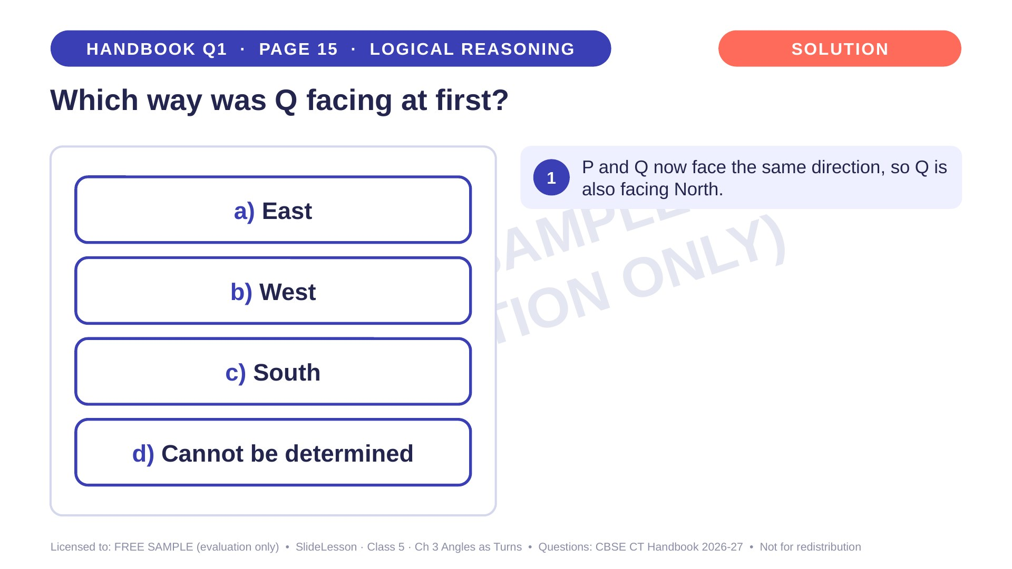
Notes:
Step 1 of 4

Slide 7
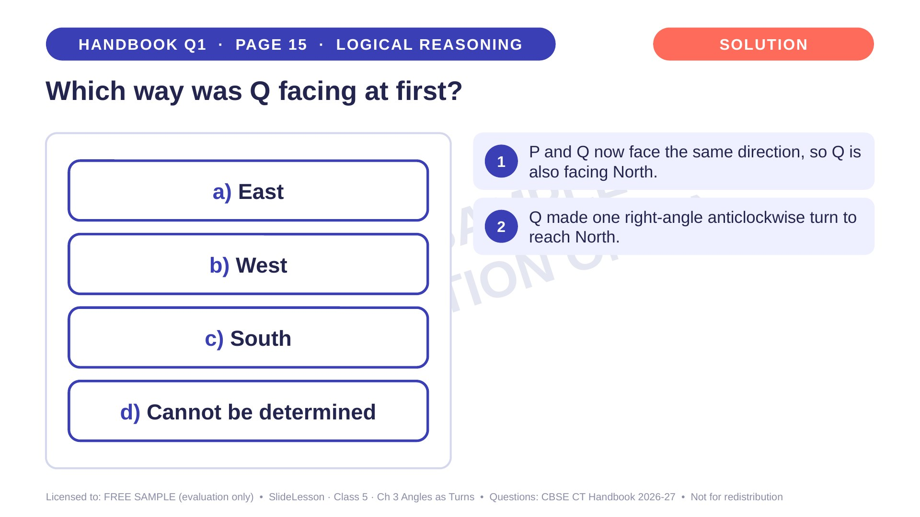
Notes:
Step 2 of 4

Slide 8
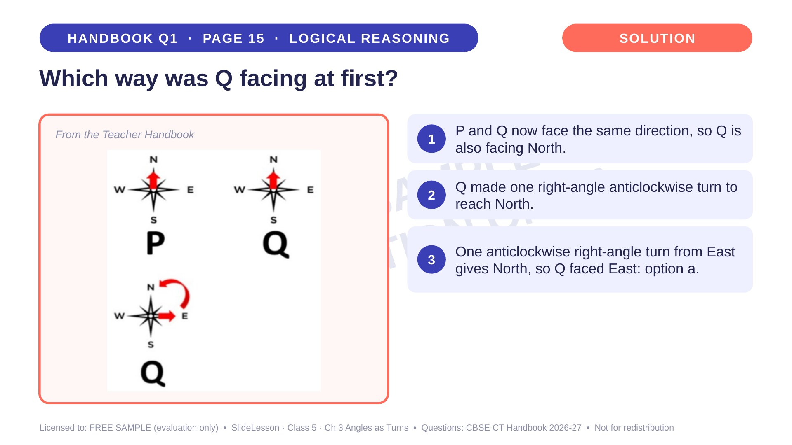
Notes:
Step 3 of 4

Slide 9
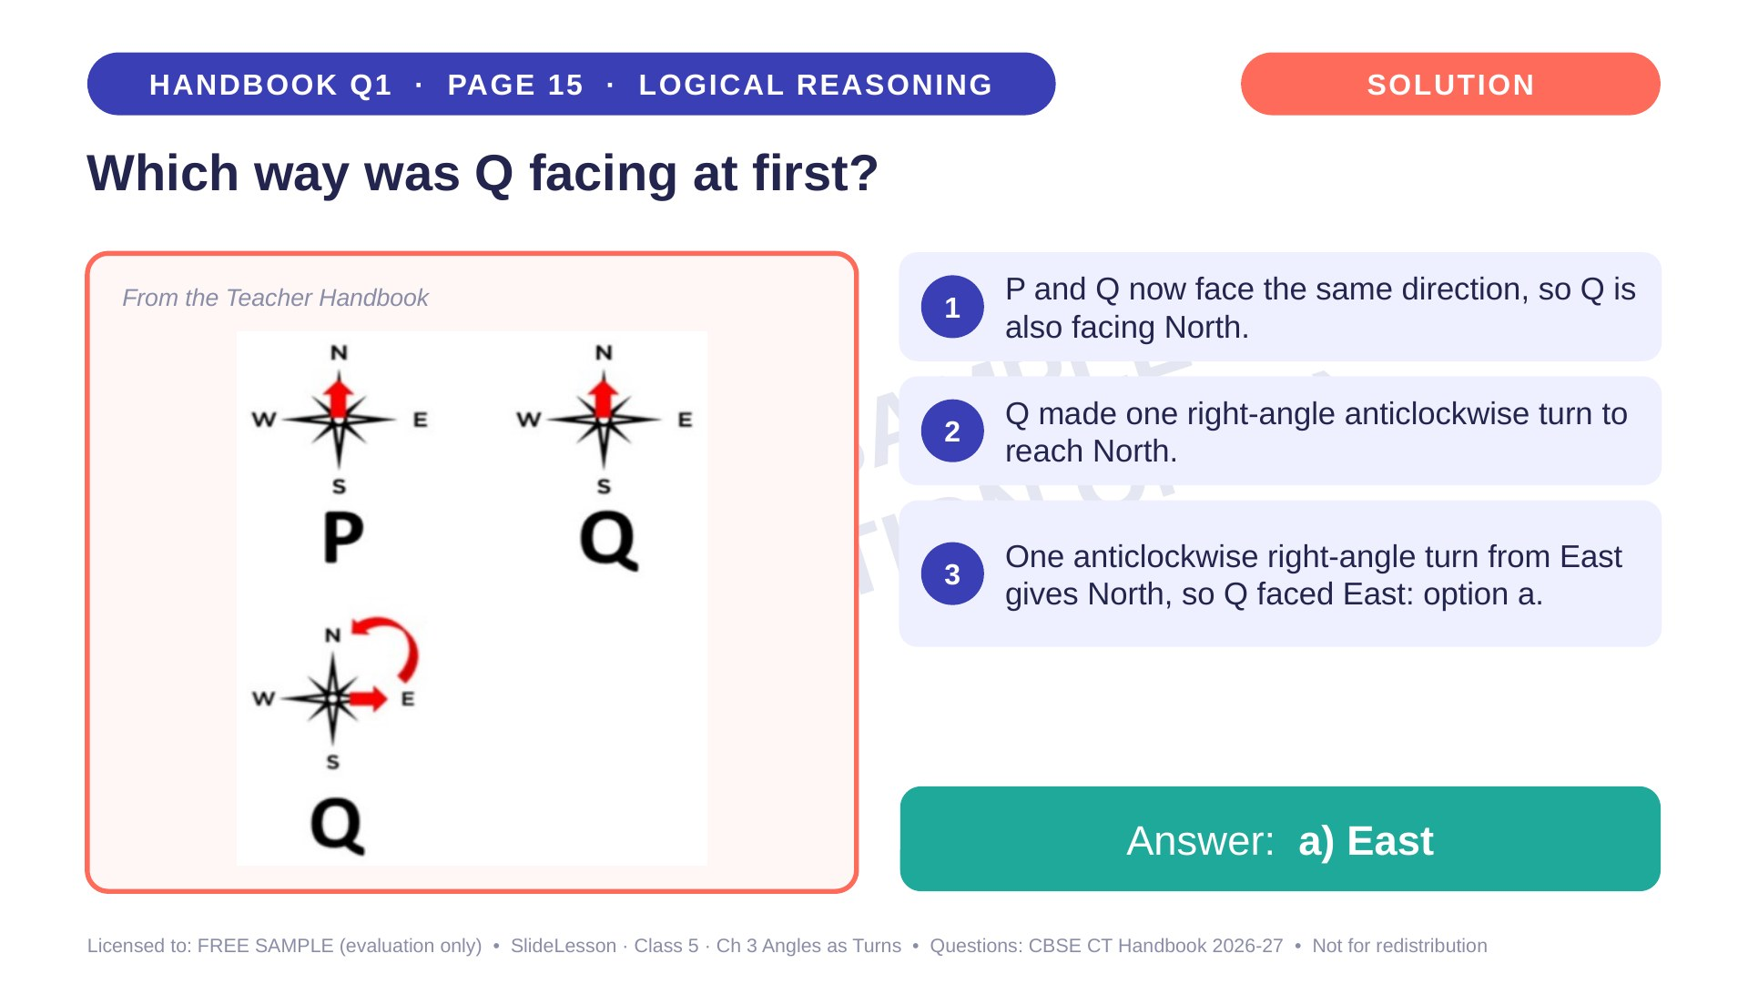
Notes:
Step 4 of 4

Slide 10
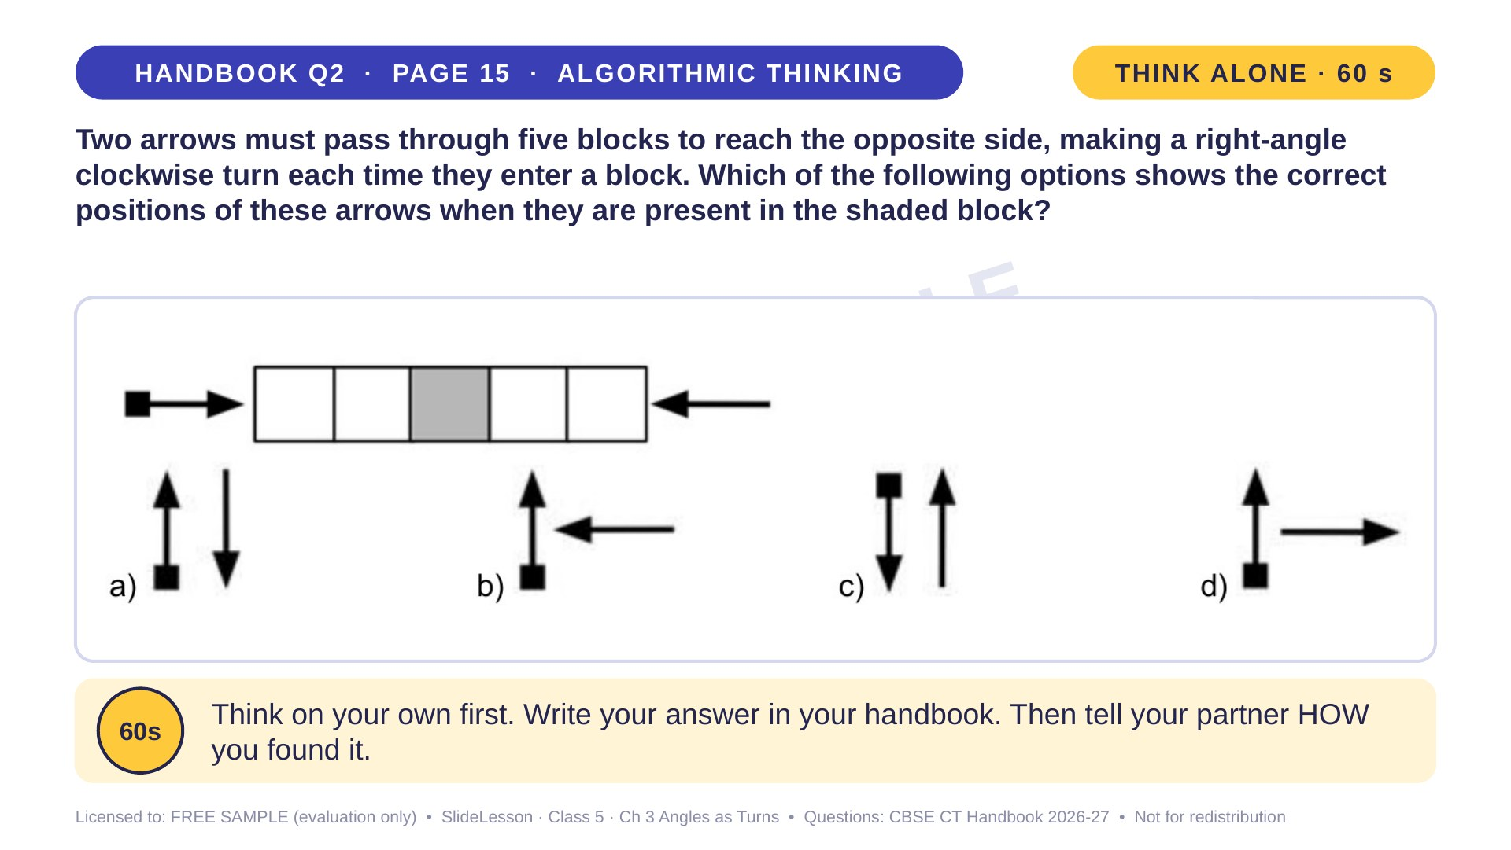
Notes:
WHILE SOLVING: let children draw the arrow in every block for each arrow separately. COMMON MISTAKE: turning the arrow anticlockwise. EXTENSION: how do both arrows look in block 4? (both point right)
ANSWER (do not tell yet): a

Slide 11
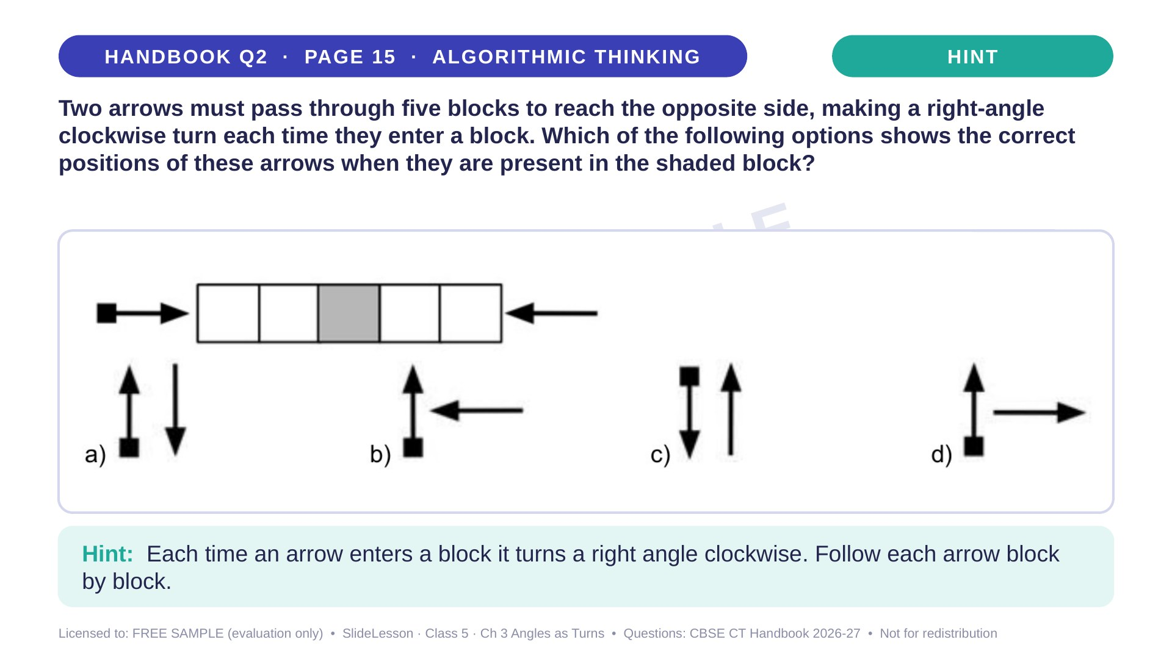
Notes:
Give the hint, then 1 more minute. Ask 2-3 children with DIFFERENT answers to explain their thinking before moving on.
WHILE SOLVING: let children draw the arrow in every block for each arrow separately. COMMON MISTAKE: turning the arrow anticlockwise. EXTENSION: how do both arrows look in block 4? (both point right)

Slide 12
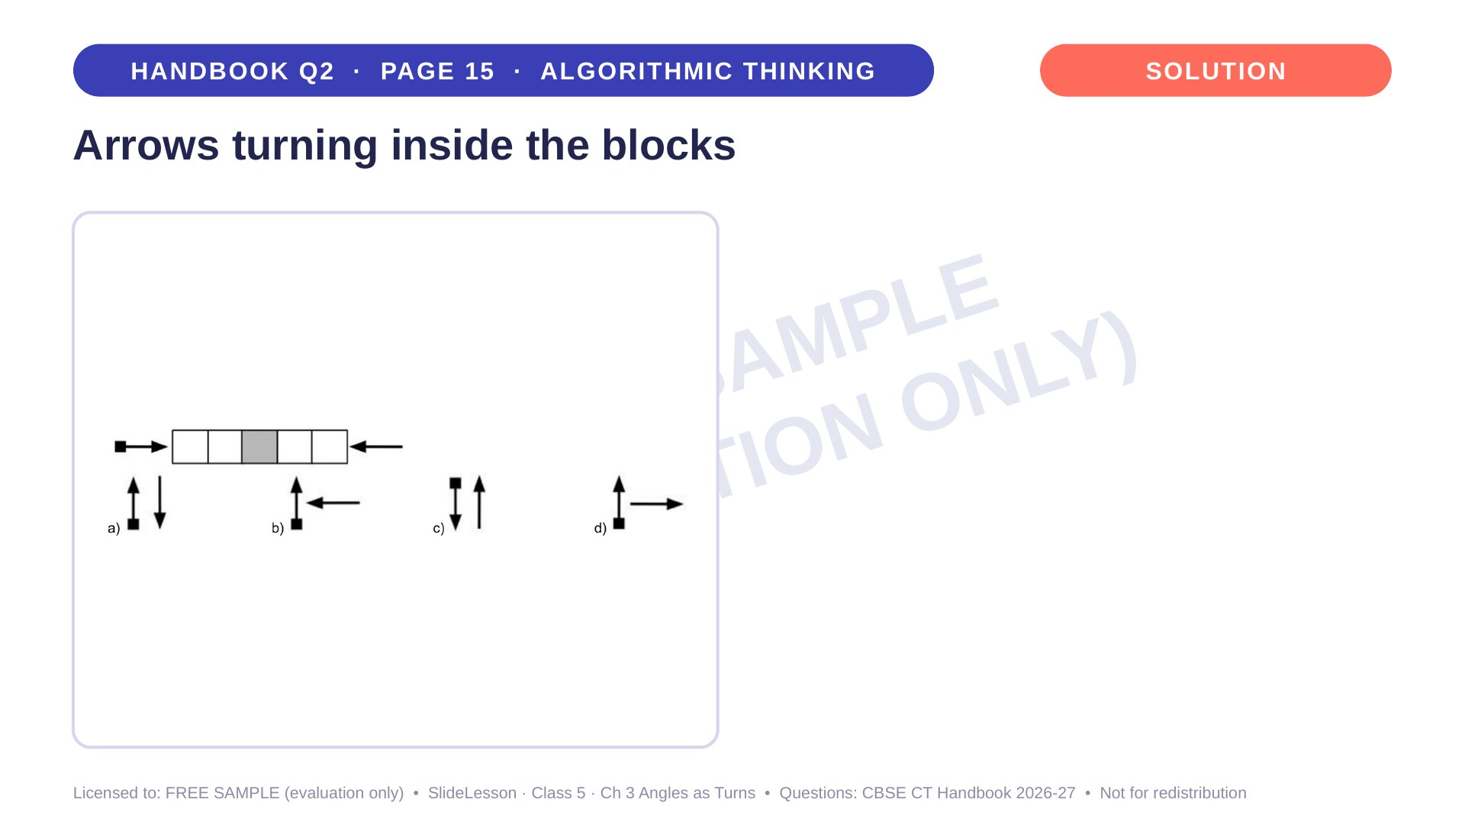
Notes:
WHILE SOLVING: let children draw the arrow in every block for each arrow separately. COMMON MISTAKE: turning the arrow anticlockwise. EXTENSION: how do both arrows look in block 4? (both point right)

Slide 13
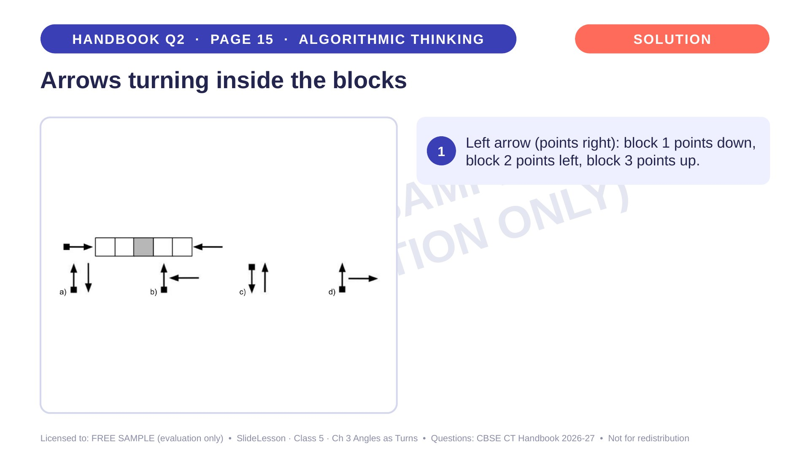
Notes:
Step 1 of 4

Slide 14
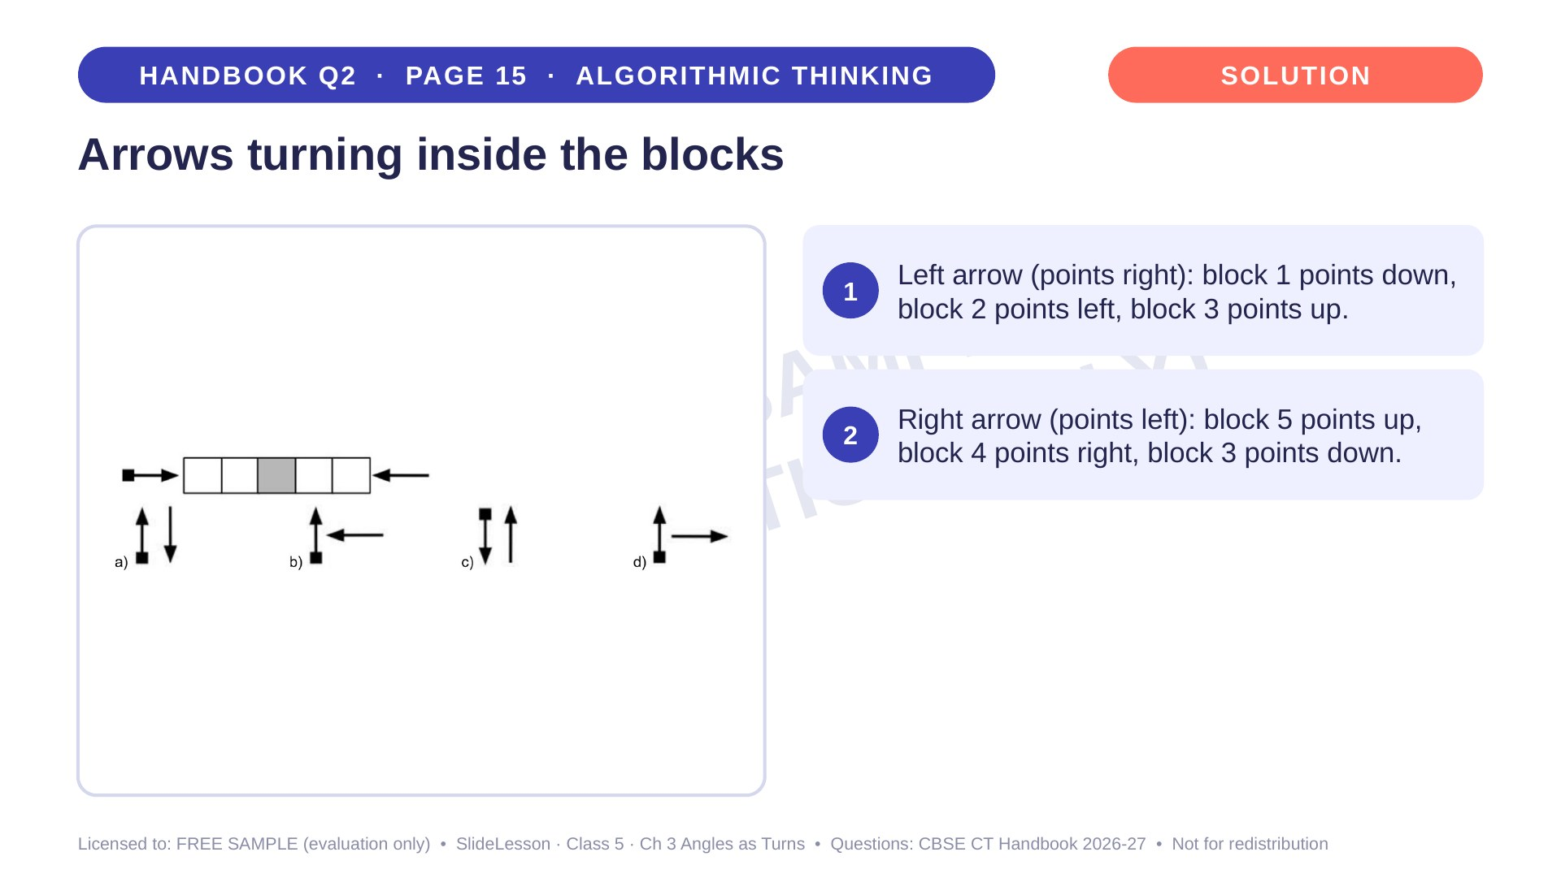
Notes:
Step 2 of 4

Slide 15
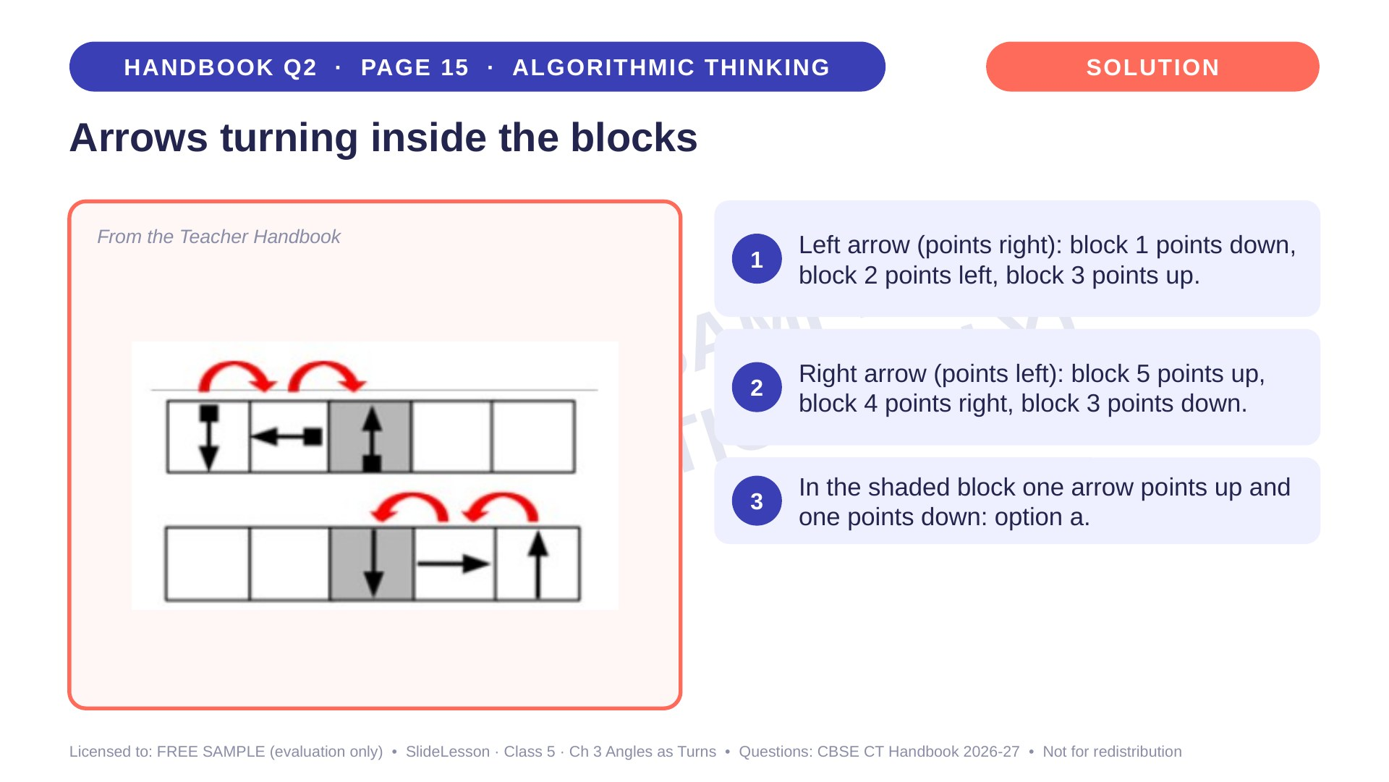
Notes:
Step 3 of 4

Slide 16
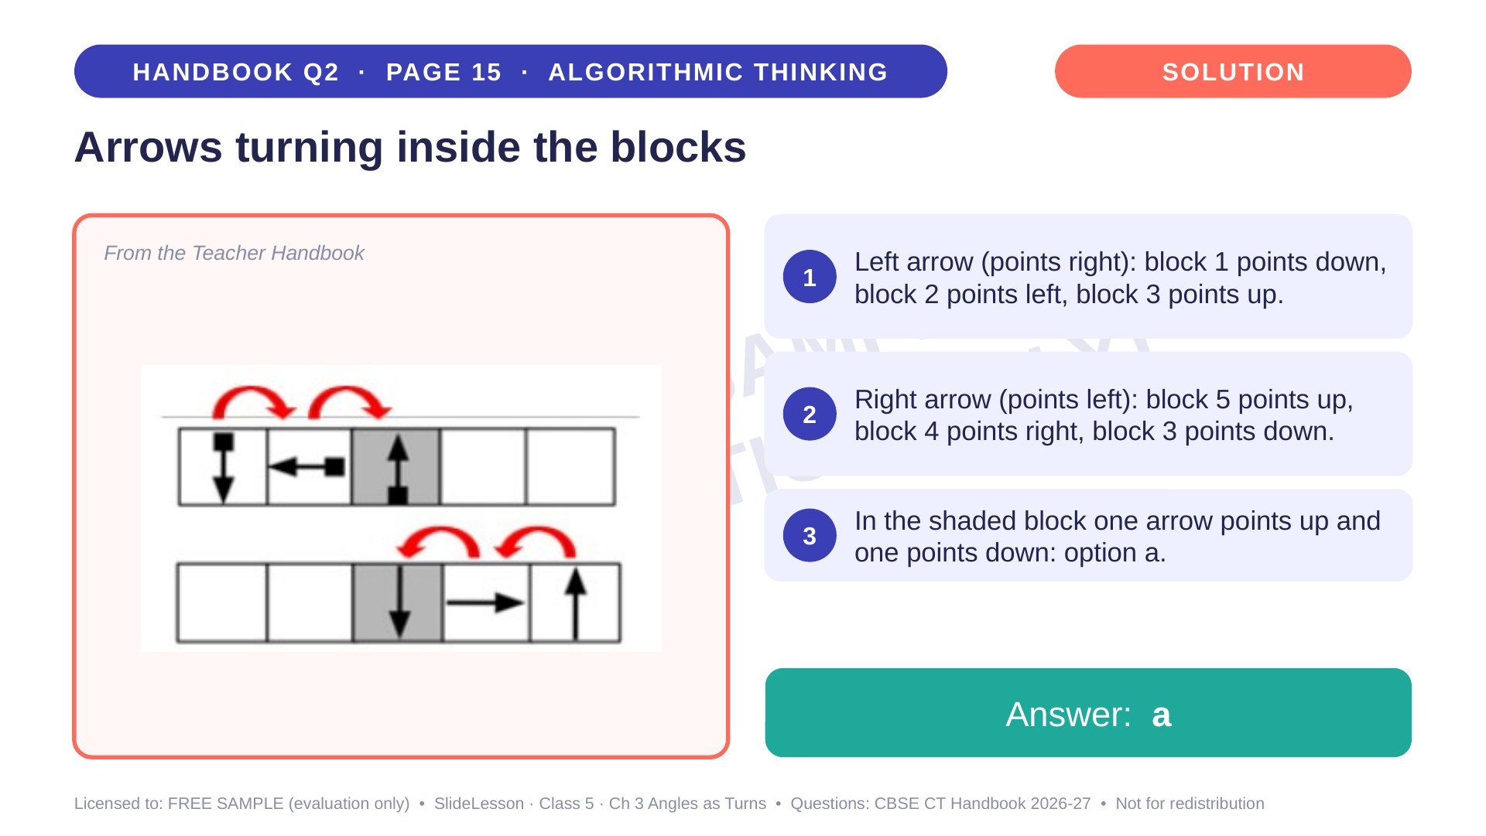
Notes:
Step 4 of 4

Slide 17
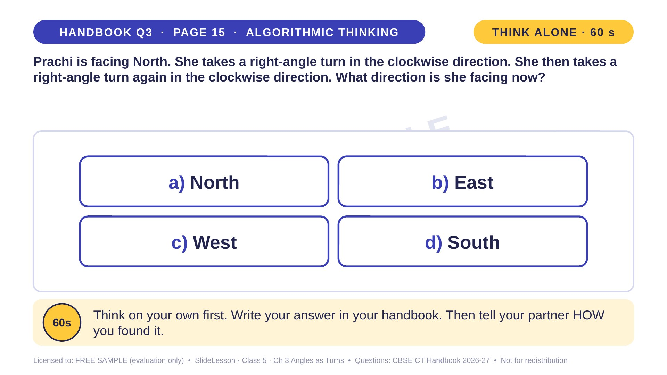
Notes:
WHILE SOLVING: label the classroom walls N, E, S, W and let children turn. COMMON MISTAKE: mixing up clockwise with anticlockwise. EXTENSION: after a third clockwise turn, where does she face? (West)
ANSWER (do not tell yet): d) South

Slide 18
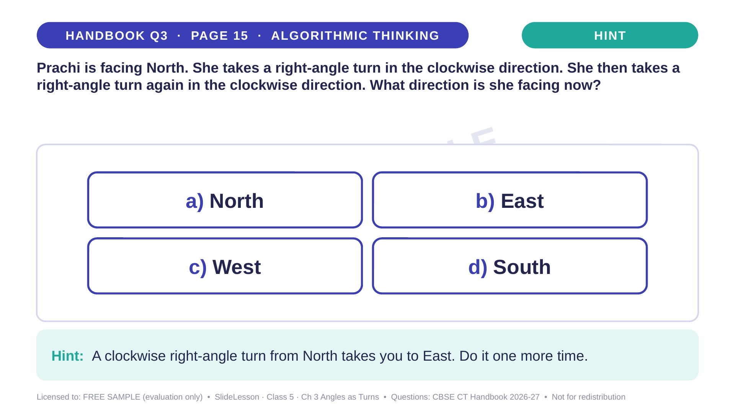
Notes:
Give the hint, then 1 more minute. Ask 2-3 children with DIFFERENT answers to explain their thinking before moving on.
WHILE SOLVING: label the classroom walls N, E, S, W and let children turn. COMMON MISTAKE: mixing up clockwise with anticlockwise. EXTENSION: after a third clockwise turn, where does she face? (West)

Slide 19
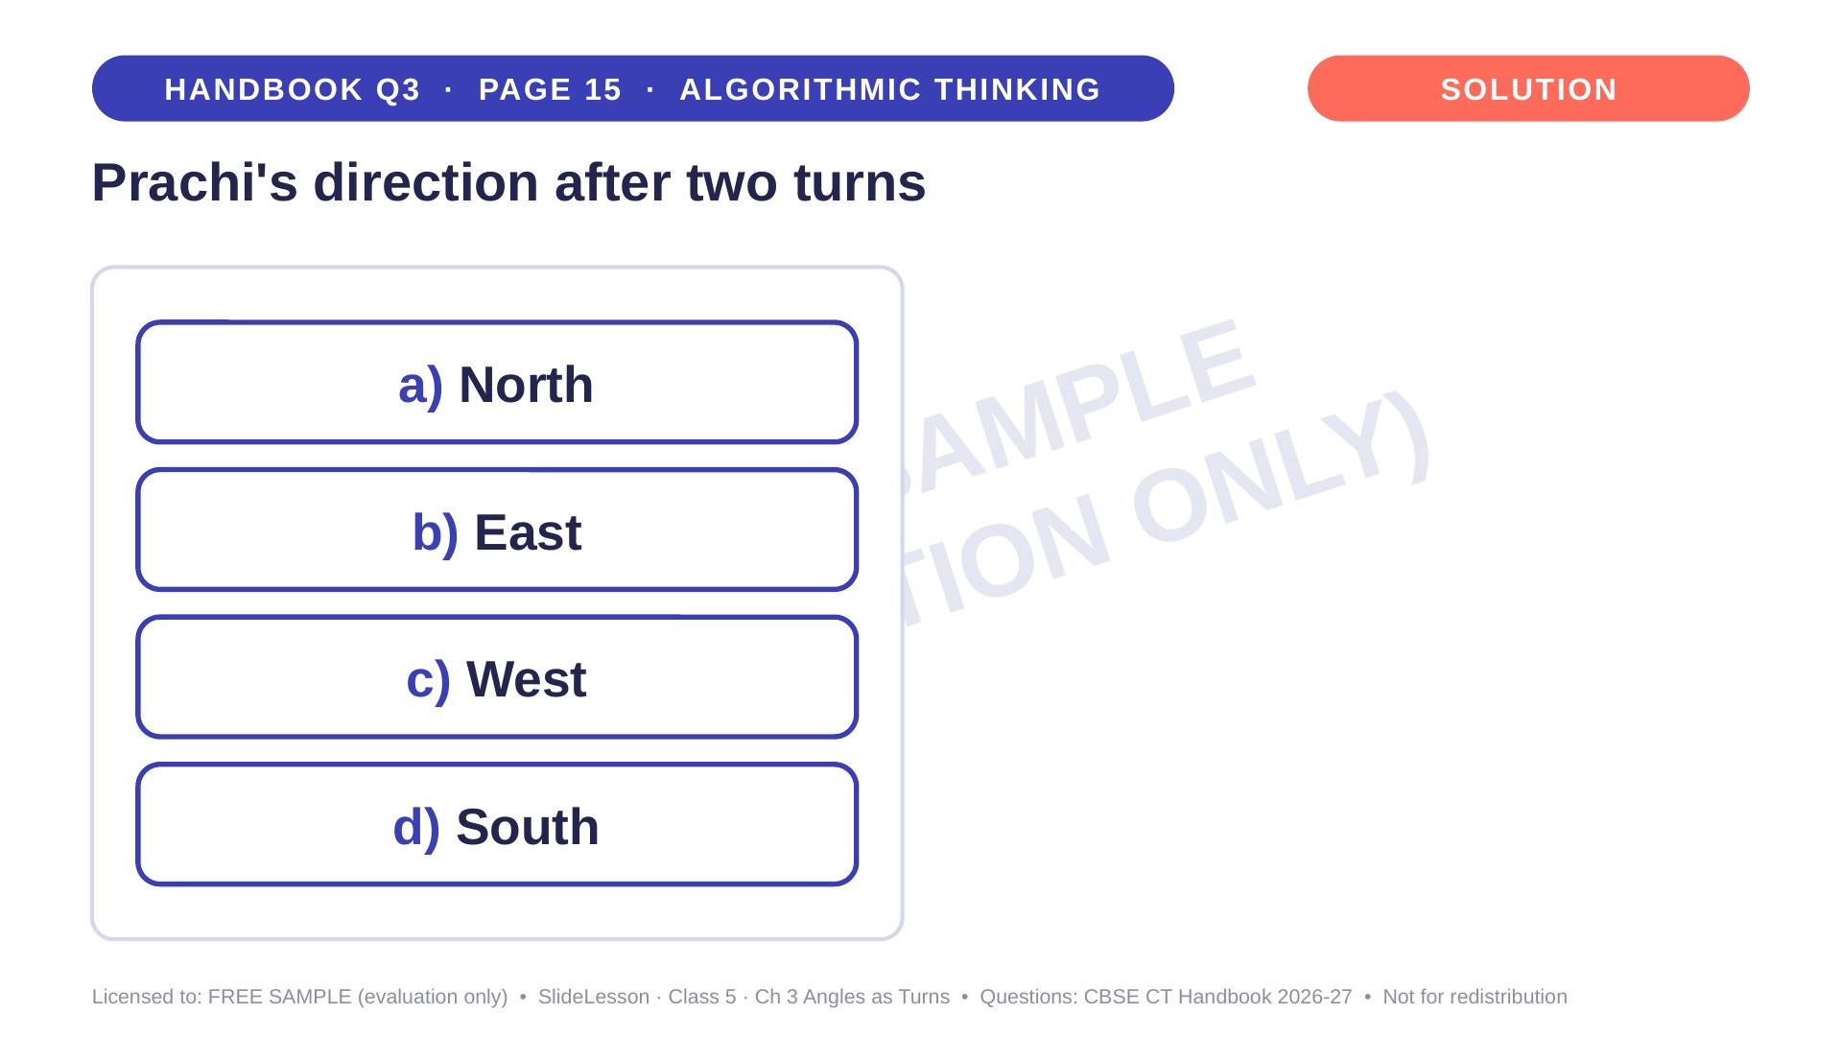
Notes:
WHILE SOLVING: label the classroom walls N, E, S, W and let children turn. COMMON MISTAKE: mixing up clockwise with anticlockwise. EXTENSION: after a third clockwise turn, where does she face? (West)

Slide 20
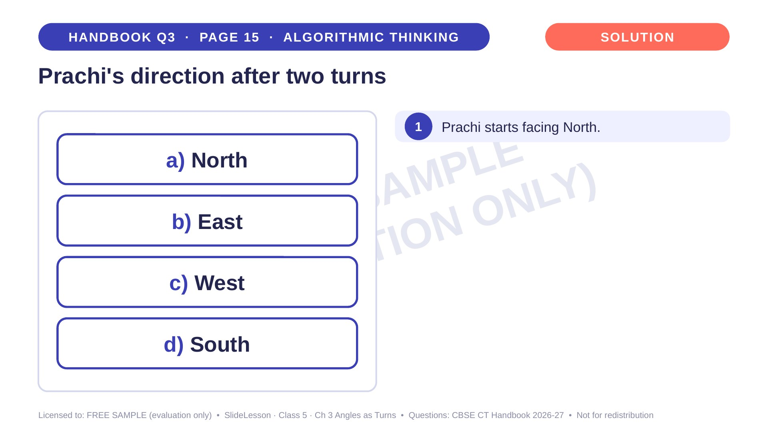
Notes:
Step 1 of 4

Slide 21
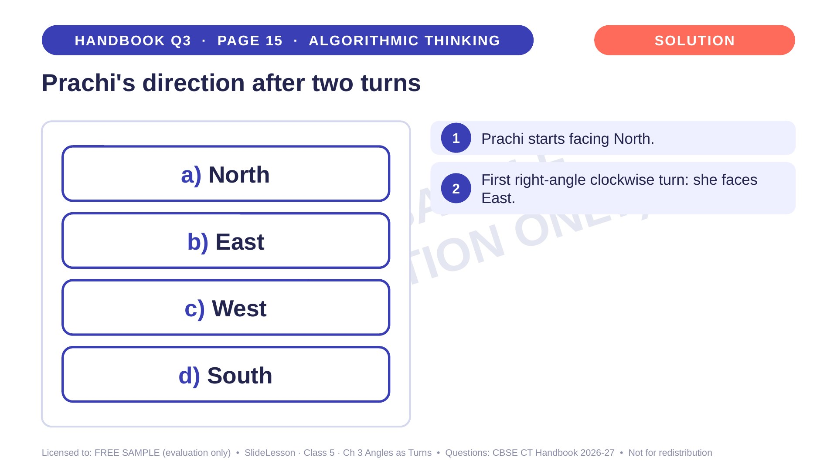
Notes:
Step 2 of 4

Slide 22
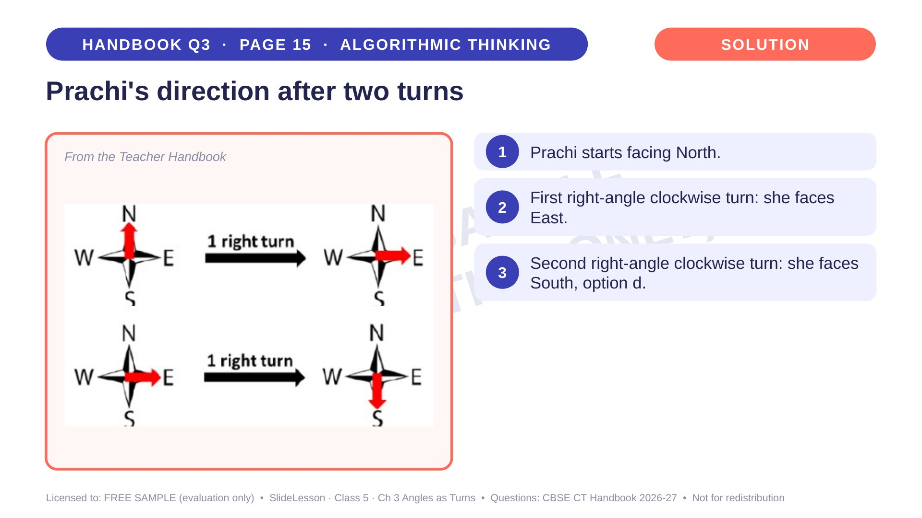
Notes:
Step 3 of 4

Slide 23
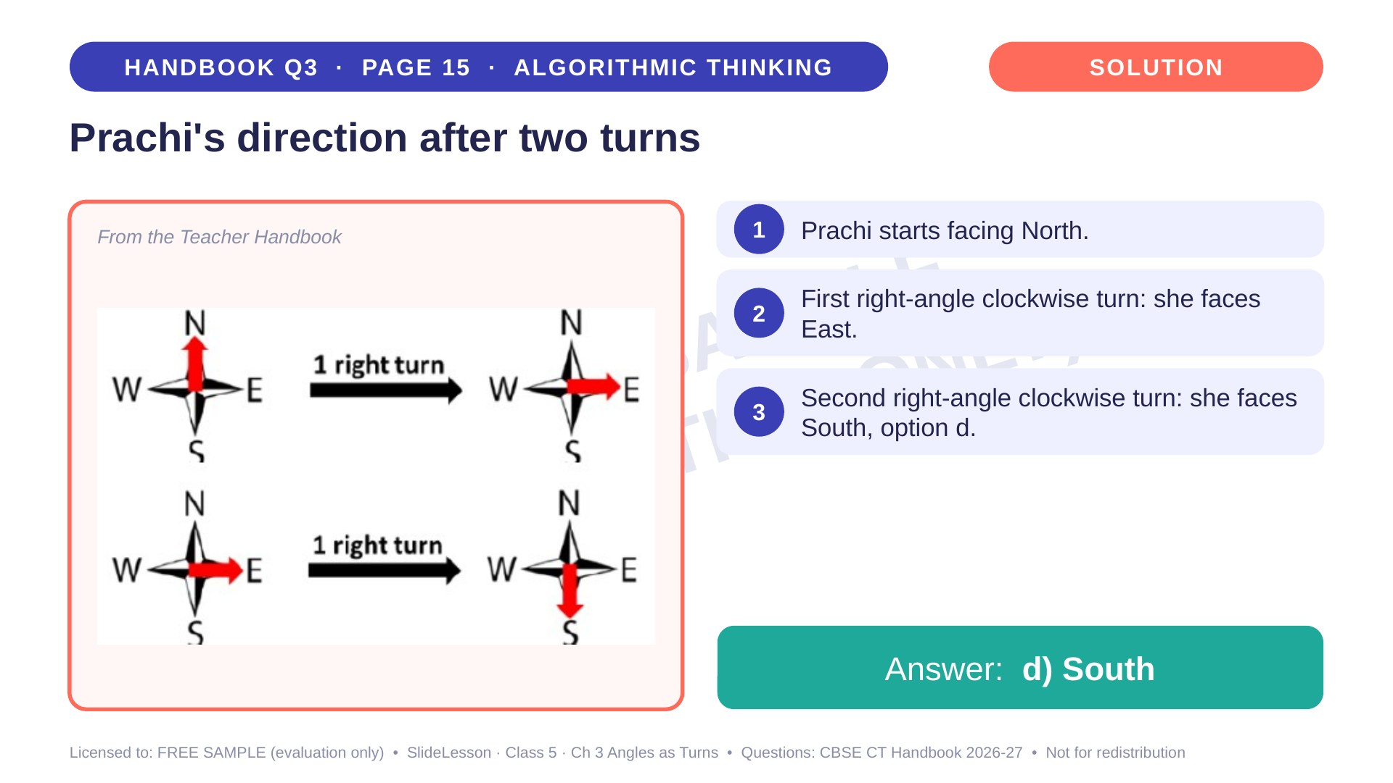
Notes:
Step 4 of 4

Slide 24
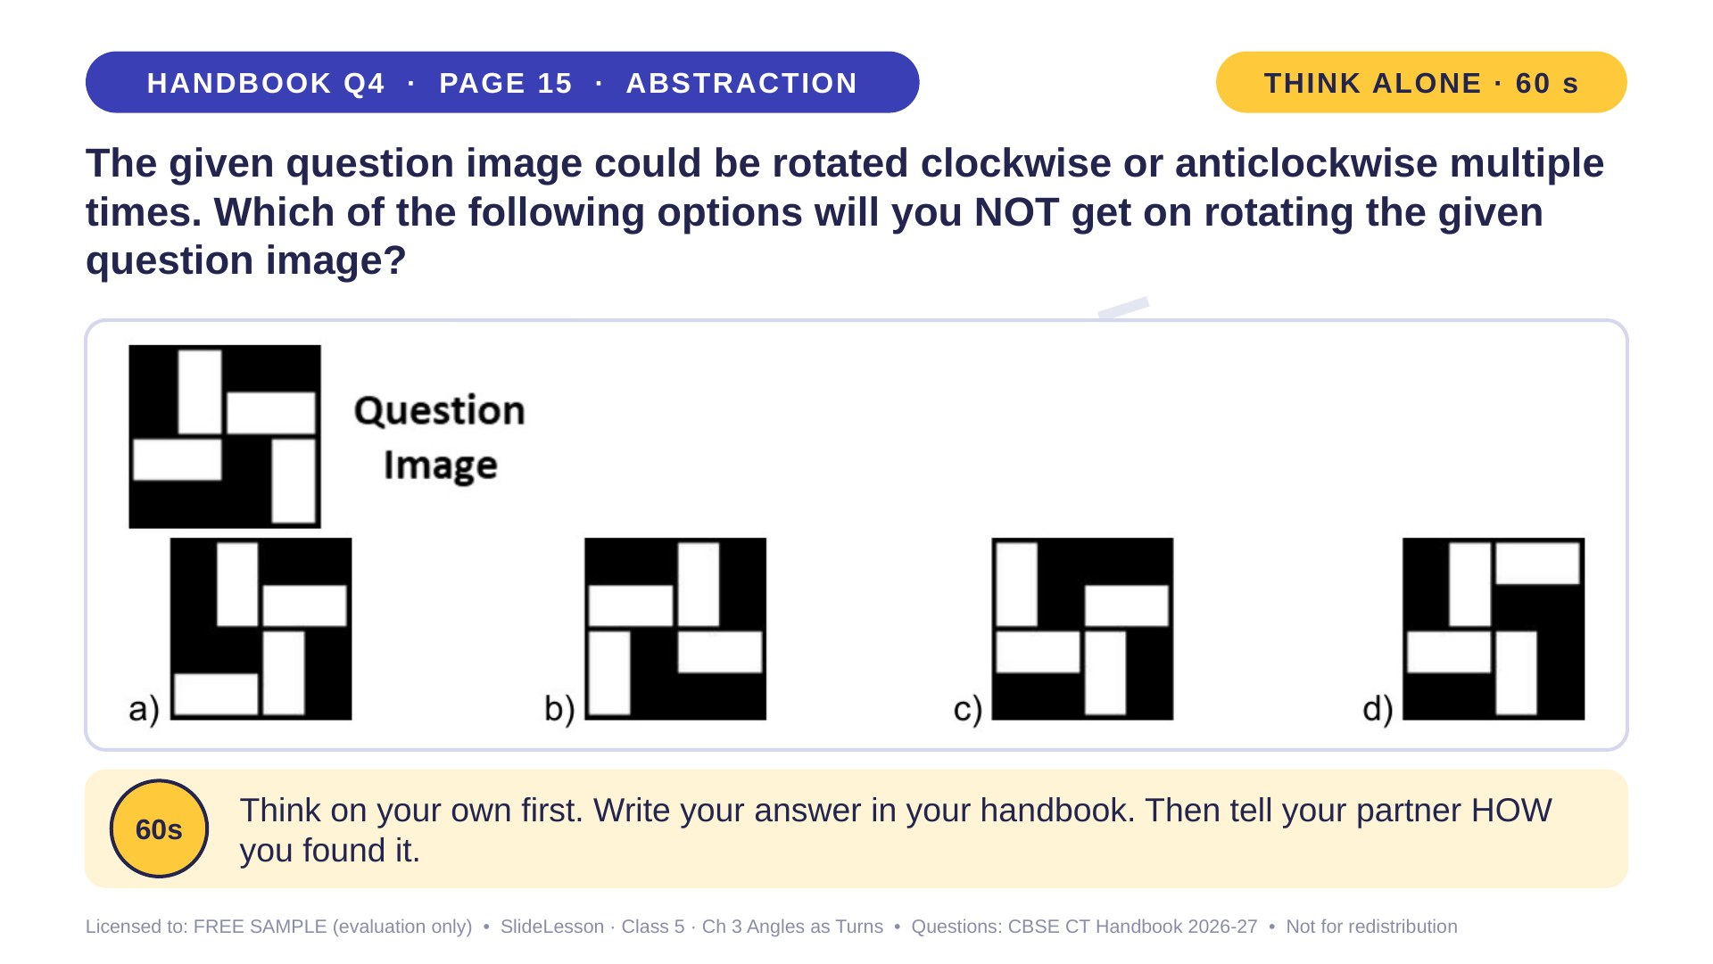
Notes:
WHILE SOLVING: draw the image on tracing paper and rotate it over each option. COMMON MISTAKE: judging only by where the corner rectangles are, not which way the arms point. EXTENSION: can a turn ever change a pattern into its mirror image? (No, it needs a flip)
ANSWER (do not tell yet): b

Slide 25
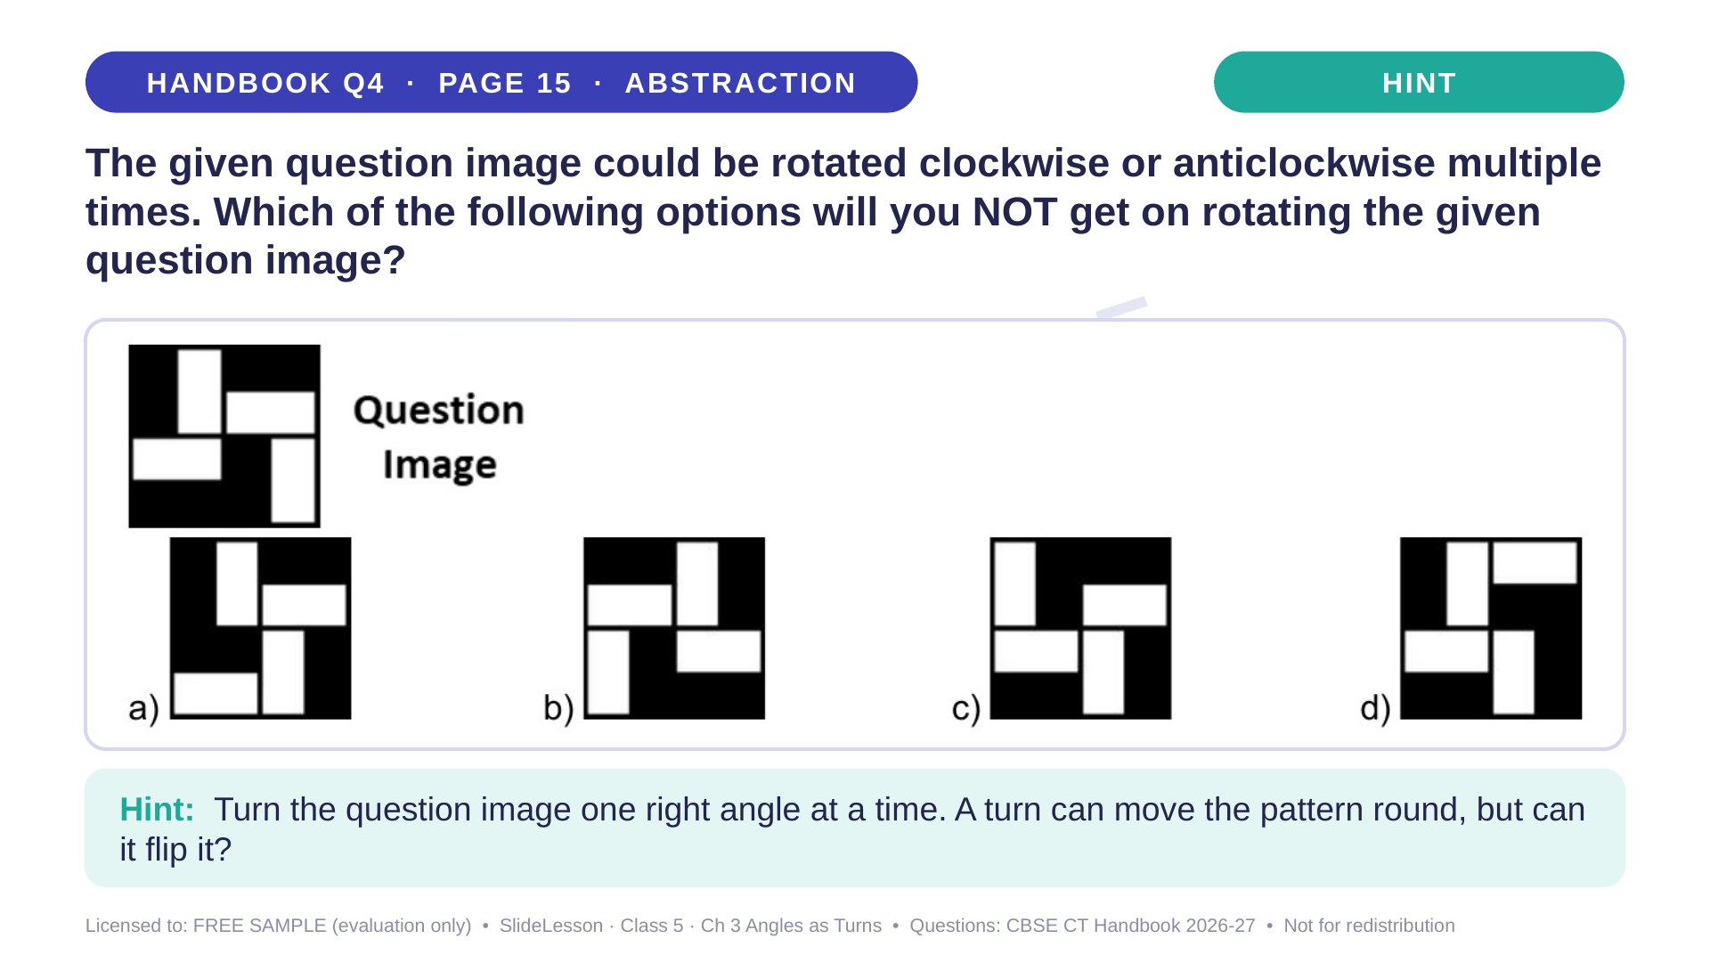
Notes:
Give the hint, then 1 more minute. Ask 2-3 children with DIFFERENT answers to explain their thinking before moving on.
WHILE SOLVING: draw the image on tracing paper and rotate it over each option. COMMON MISTAKE: judging only by where the corner rectangles are, not which way the arms point. EXTENSION: can a turn ever change a pattern into its mirror image? (No, it needs a flip)

Slide 26
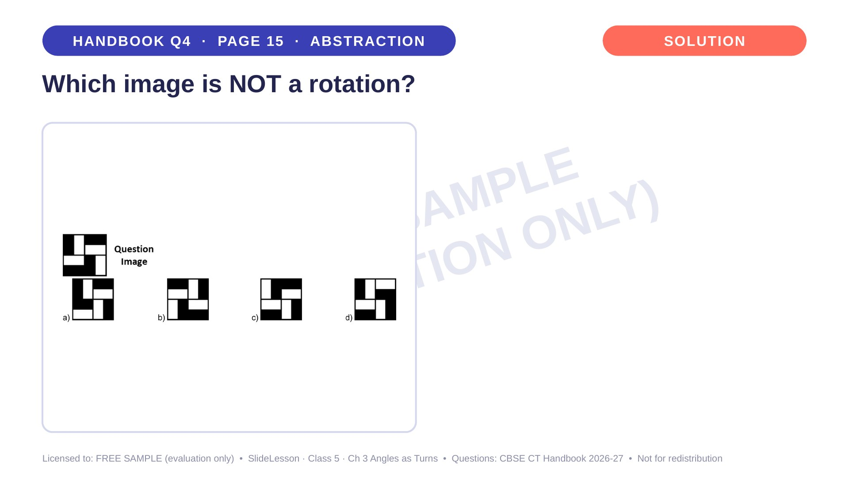
Notes:
WHILE SOLVING: draw the image on tracing paper and rotate it over each option. COMMON MISTAKE: judging only by where the corner rectangles are, not which way the arms point. EXTENSION: can a turn ever change a pattern into its mirror image? (No, it needs a flip)

Slide 27
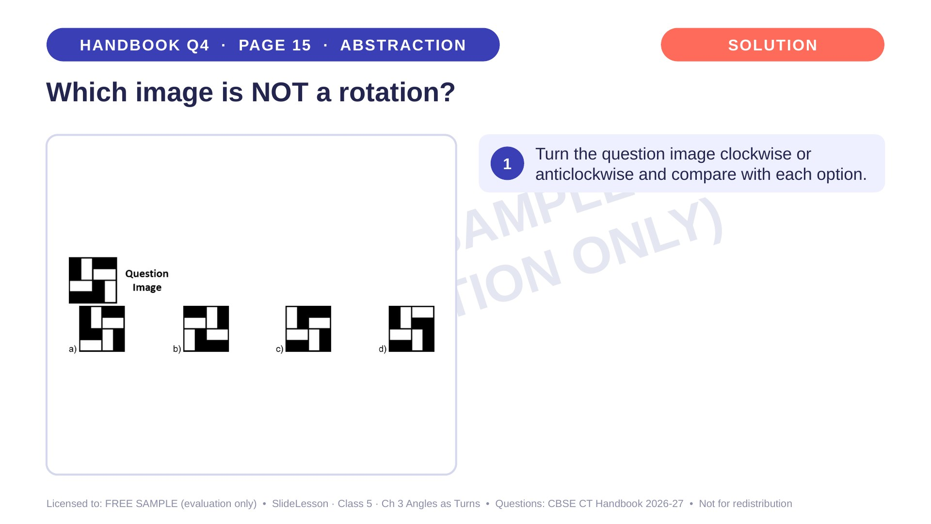
Notes:
Step 1 of 4

Slide 28
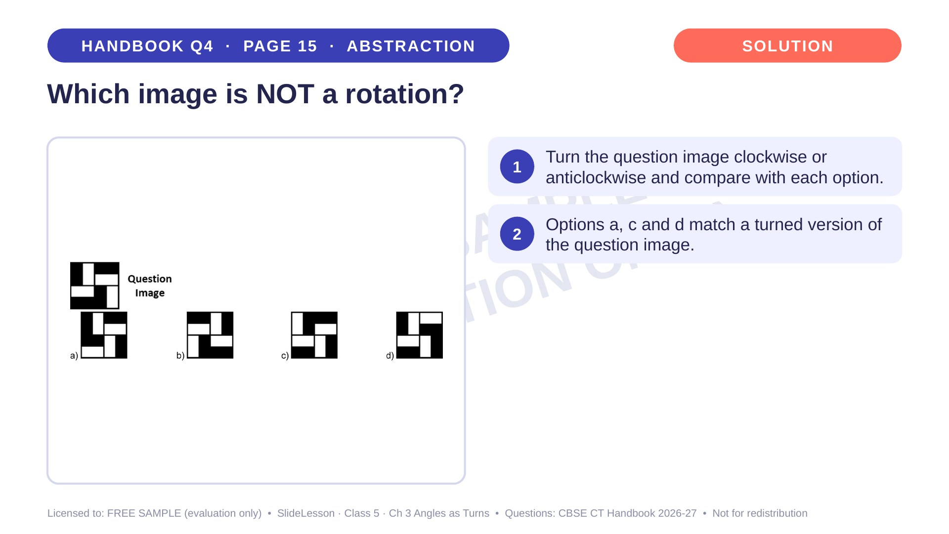
Notes:
Step 2 of 4

Slide 29
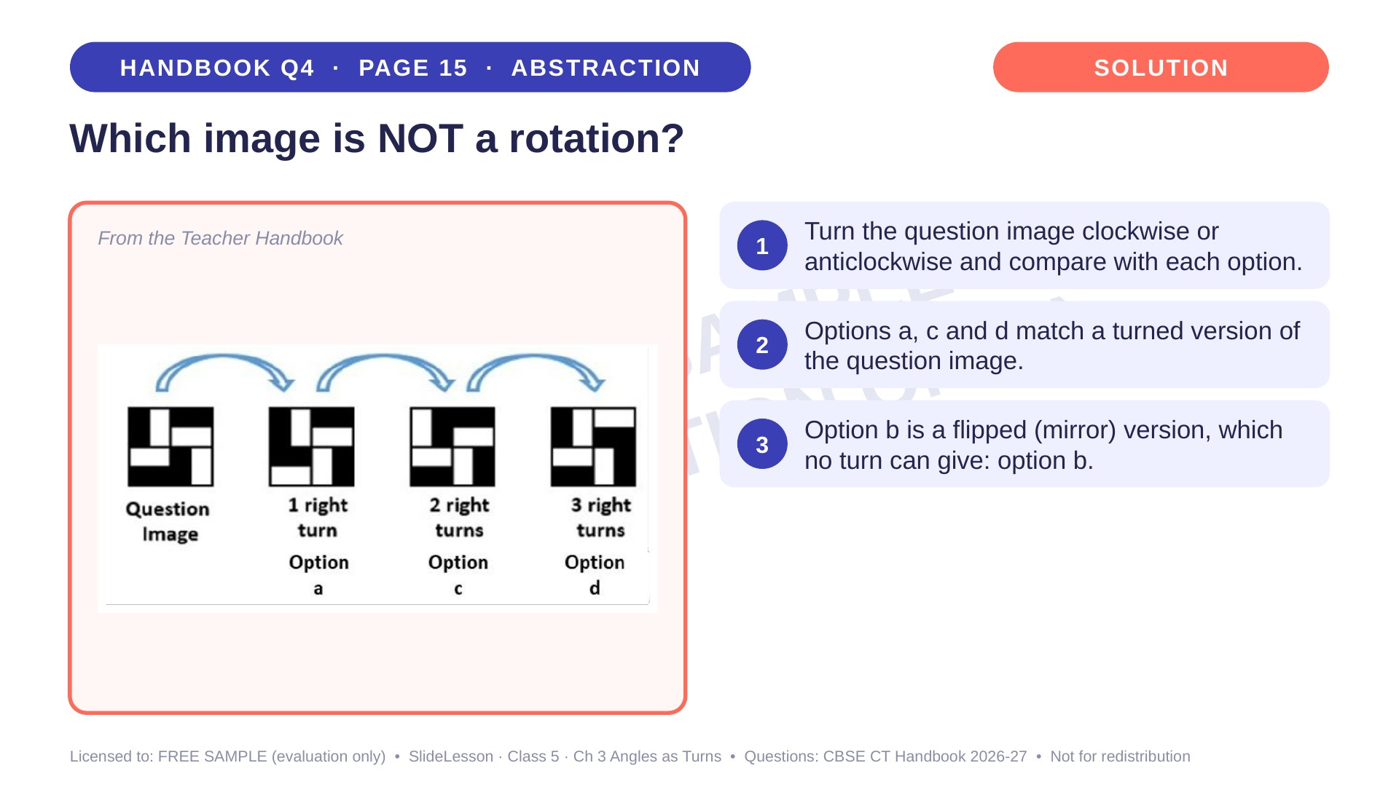
Notes:
Step 3 of 4

Slide 30
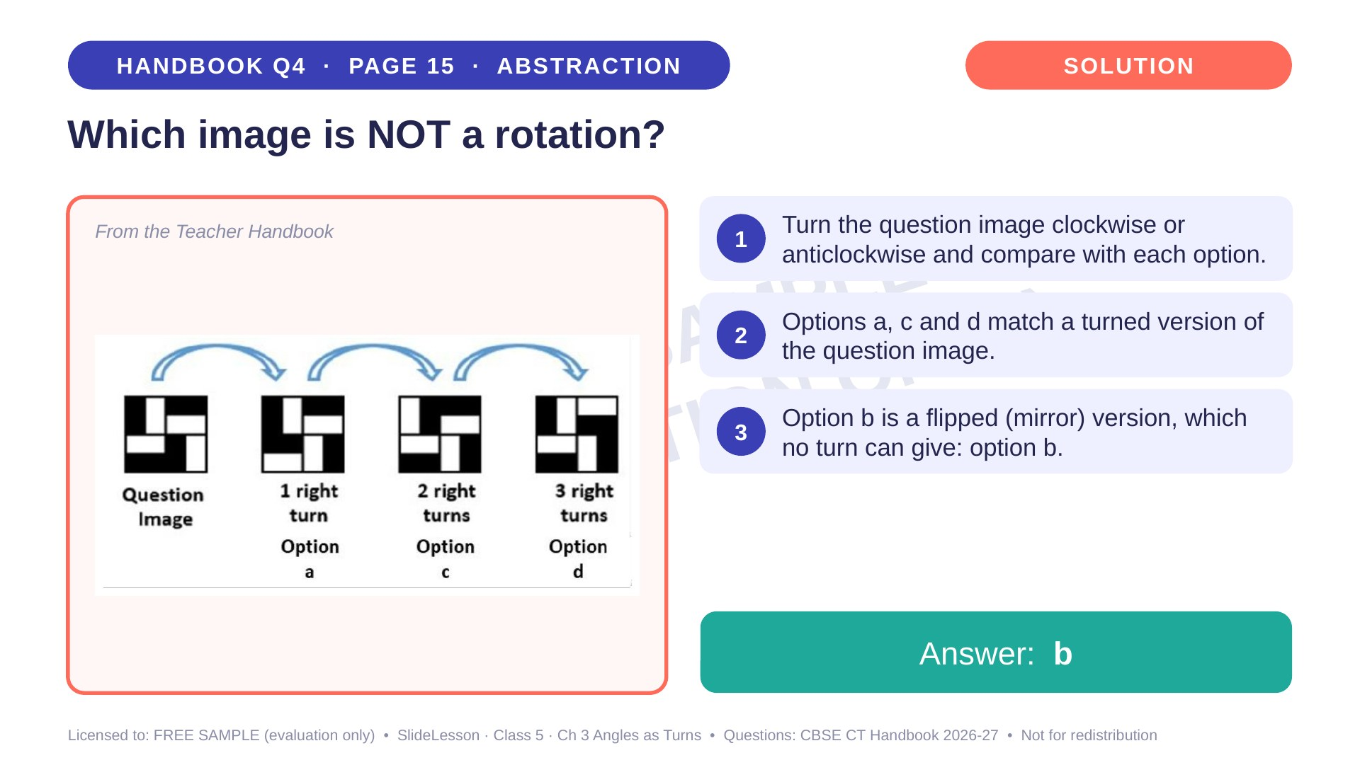
Notes:
Step 4 of 4

Slide 31
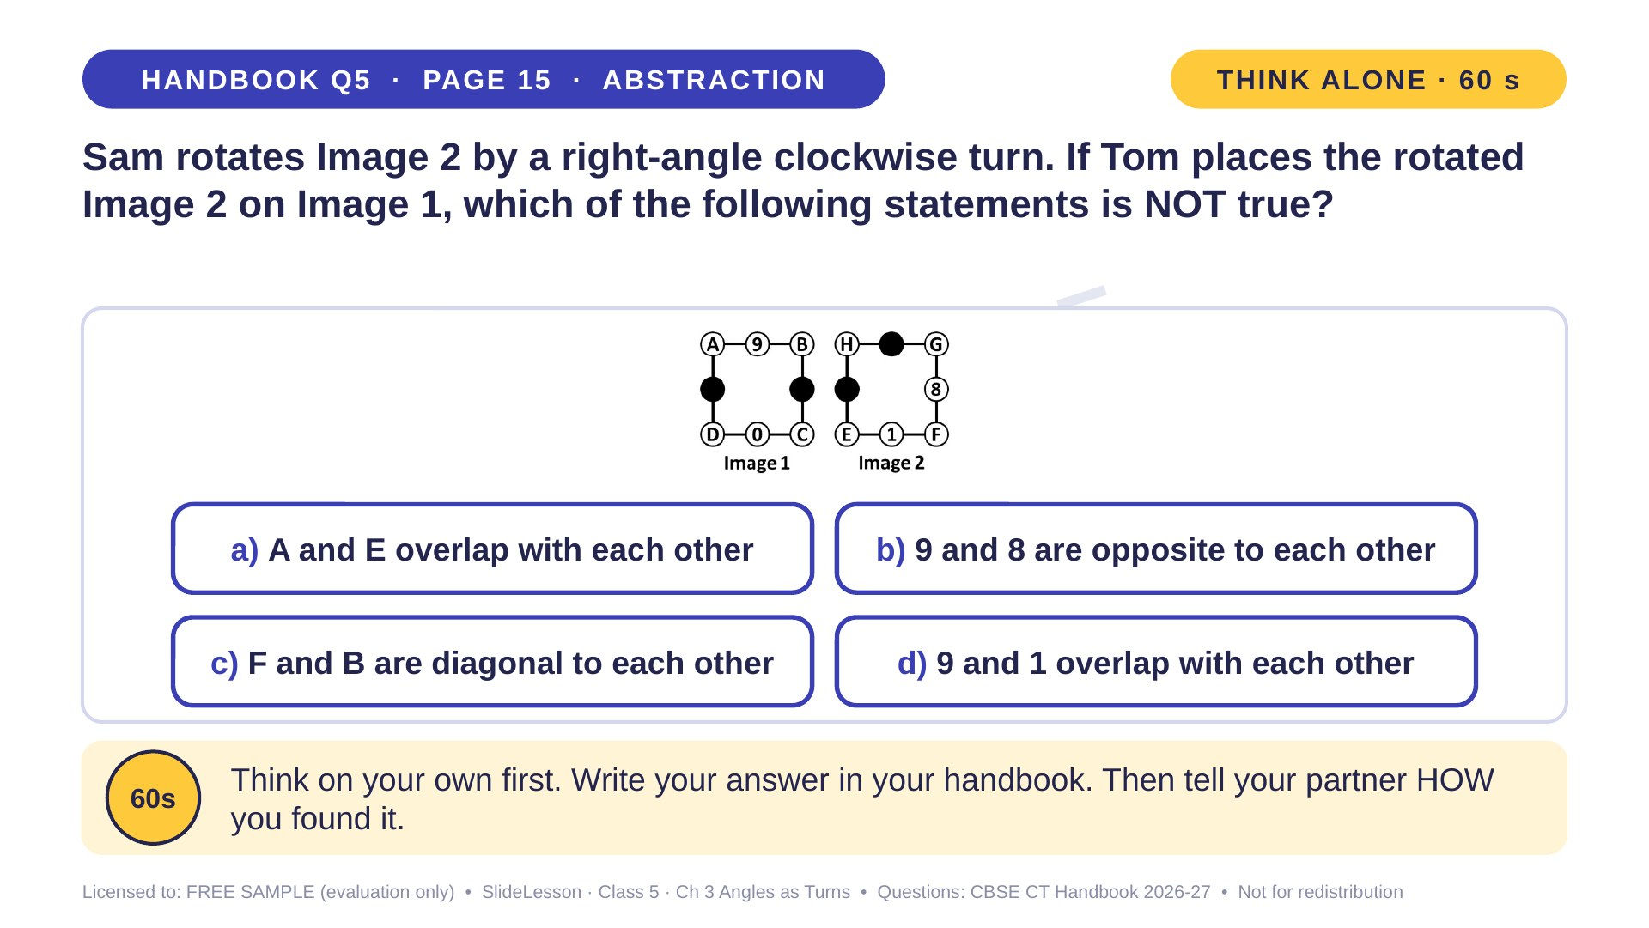
Notes:
WHILE SOLVING: copy Image 2 on tracing paper, rotate it and lay it on Image 1. COMMON MISTAKE: rotating anticlockwise. EXTENSION: which number lies on 0 after the turn? (8)
ANSWER (do not tell yet): d) 9 and 1 overlap with each other

Slide 32
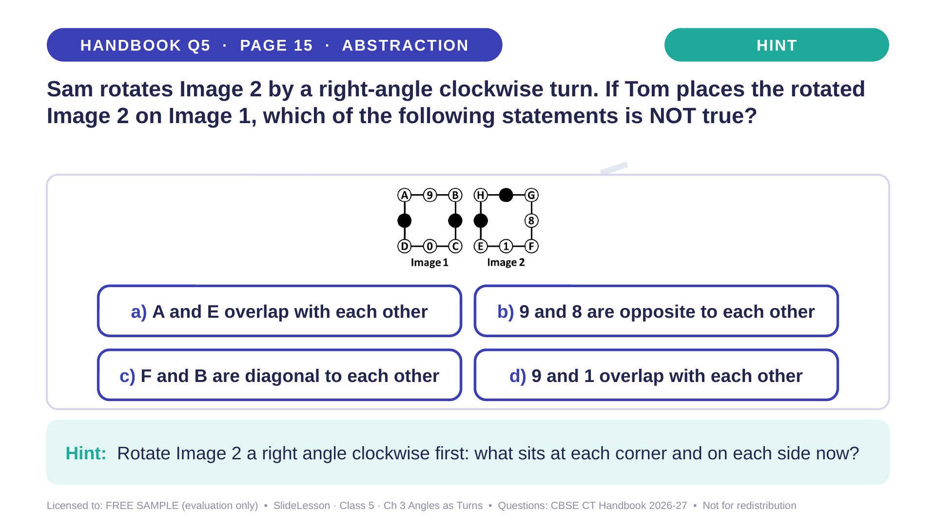
Notes:
Give the hint, then 1 more minute. Ask 2-3 children with DIFFERENT answers to explain their thinking before moving on.
WHILE SOLVING: copy Image 2 on tracing paper, rotate it and lay it on Image 1. COMMON MISTAKE: rotating anticlockwise. EXTENSION: which number lies on 0 after the turn? (8)

Slide 33
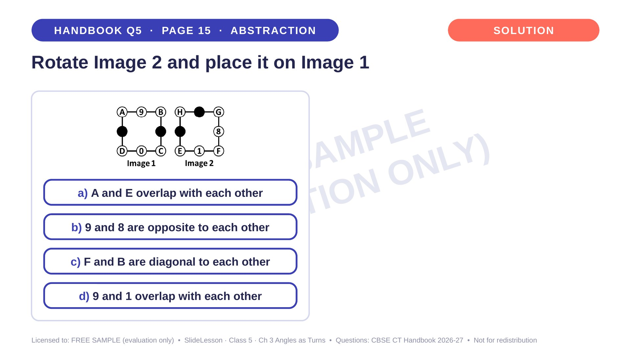
Notes:
WHILE SOLVING: copy Image 2 on tracing paper, rotate it and lay it on Image 1. COMMON MISTAKE: rotating anticlockwise. EXTENSION: which number lies on 0 after the turn? (8)

Slide 34
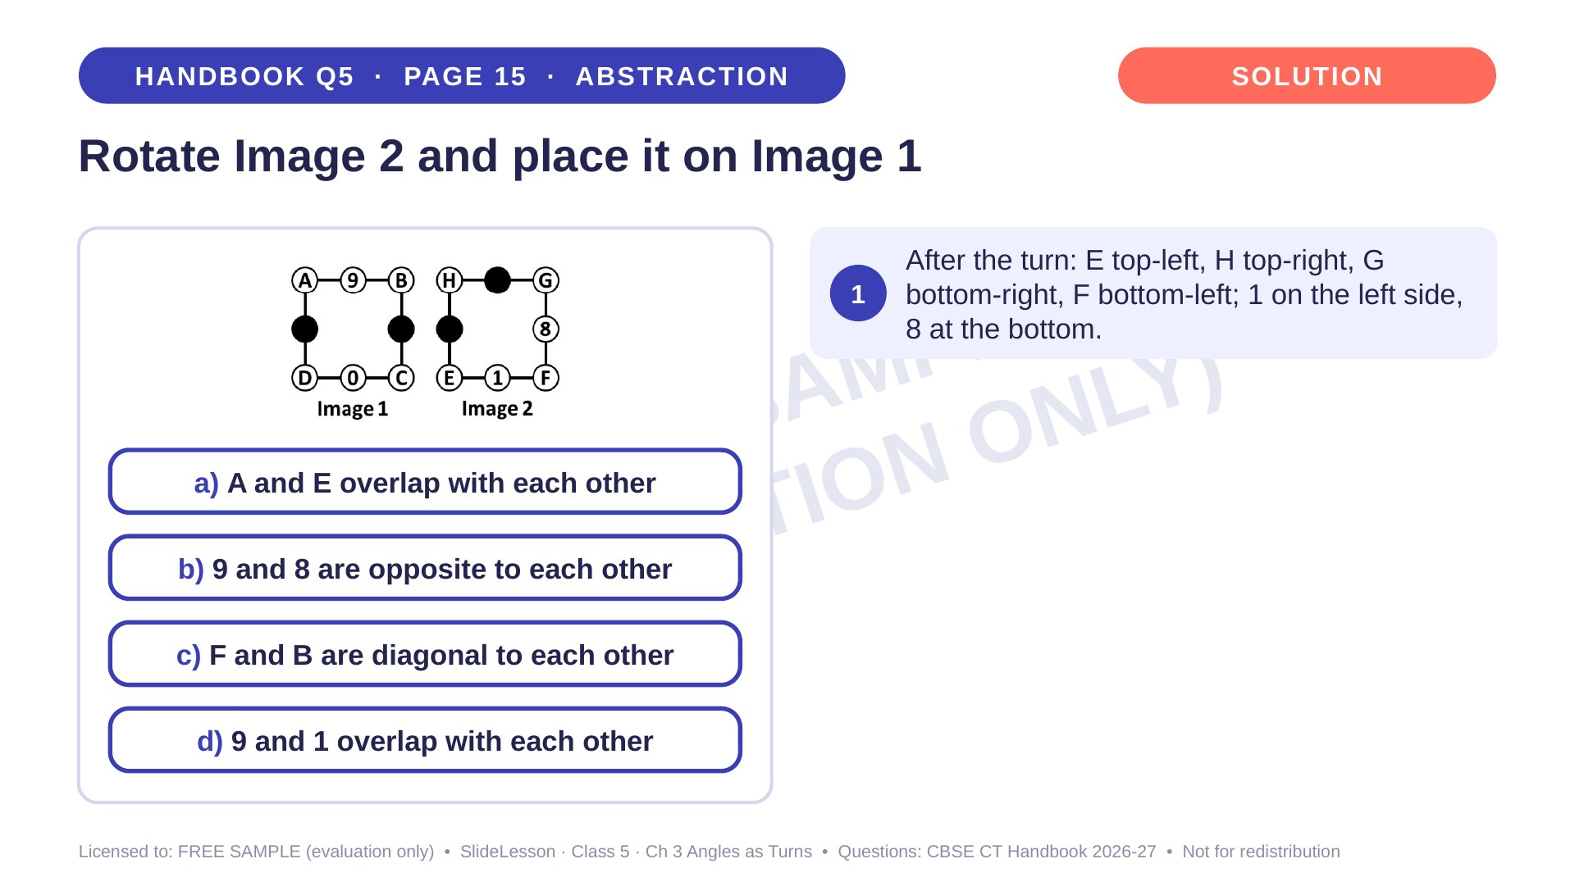
Notes:
Step 1 of 4

Slide 35
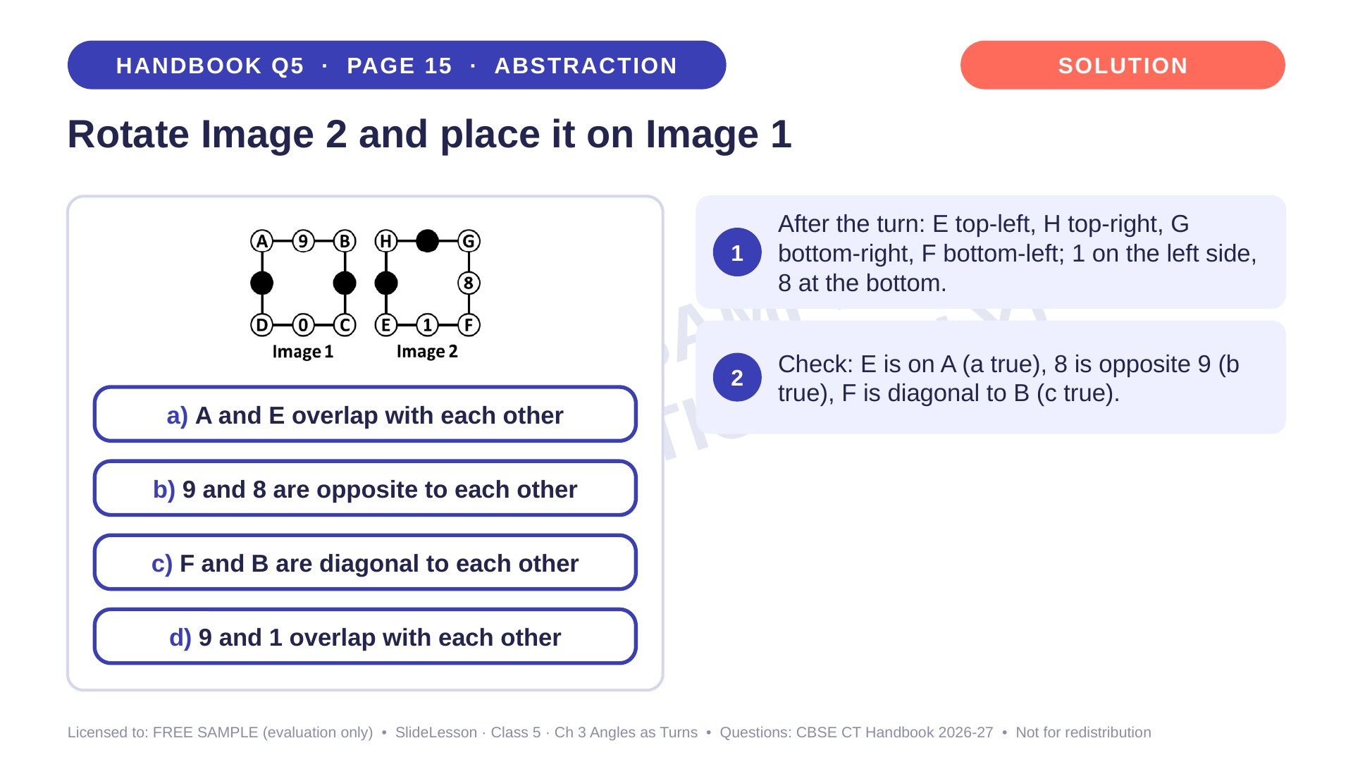
Notes:
Step 2 of 4

Slide 36
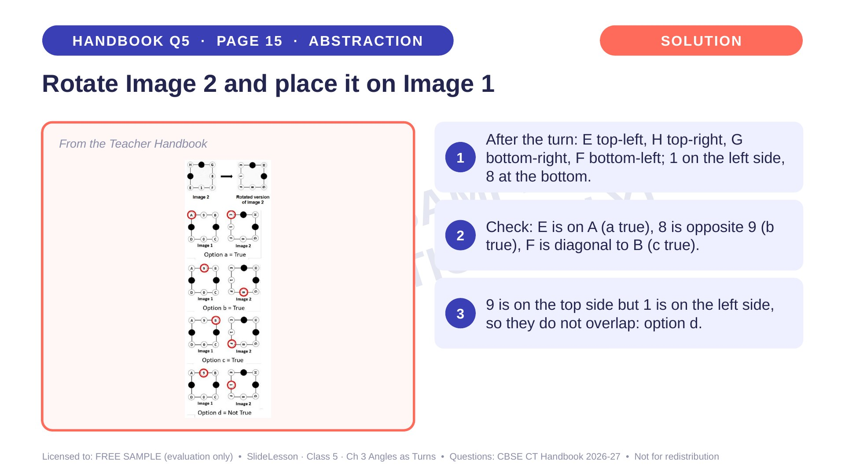
Notes:
Step 3 of 4

Slide 37
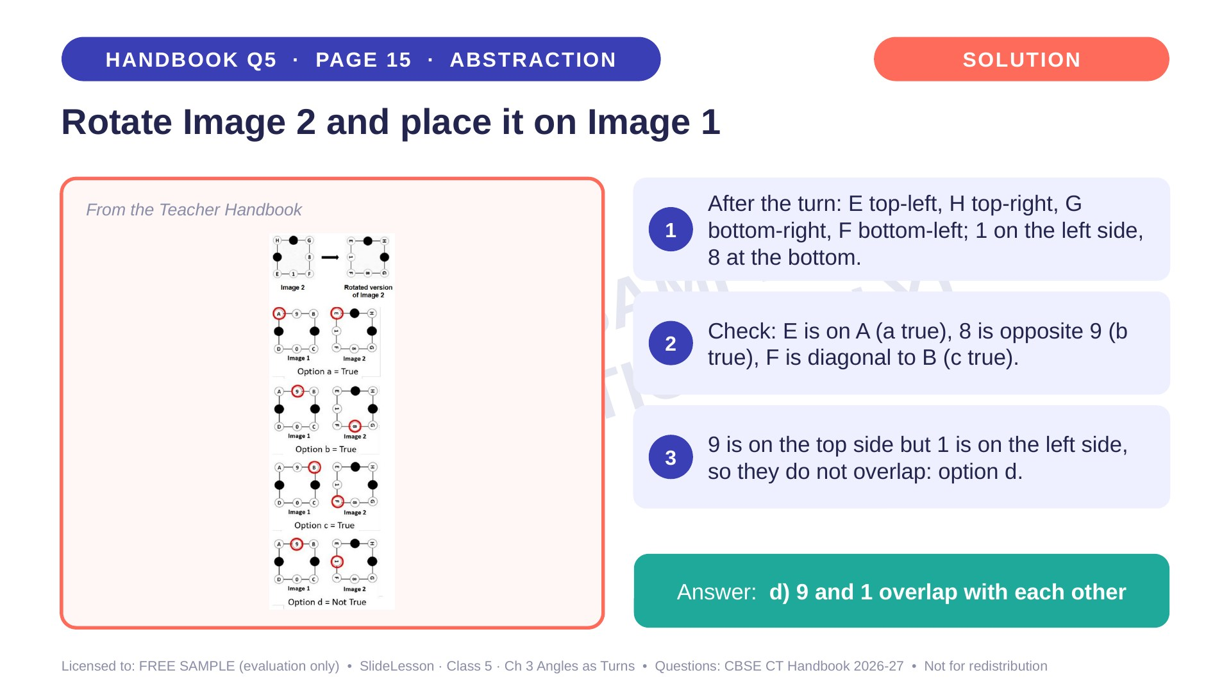
Notes:
Step 4 of 4

Slide 38
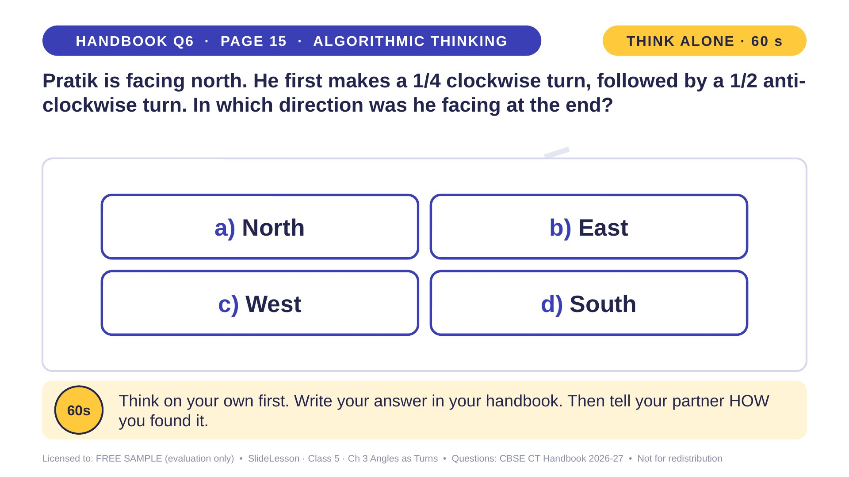
Notes:
WHILE SOLVING: have children stand and turn, calling out each direction. COMMON MISTAKE: treating a 1/2 turn as one right angle, which gives North. EXTENSION: what about a 3/4 clockwise turn from North? (West)
ANSWER (do not tell yet): c) West

Slide 39
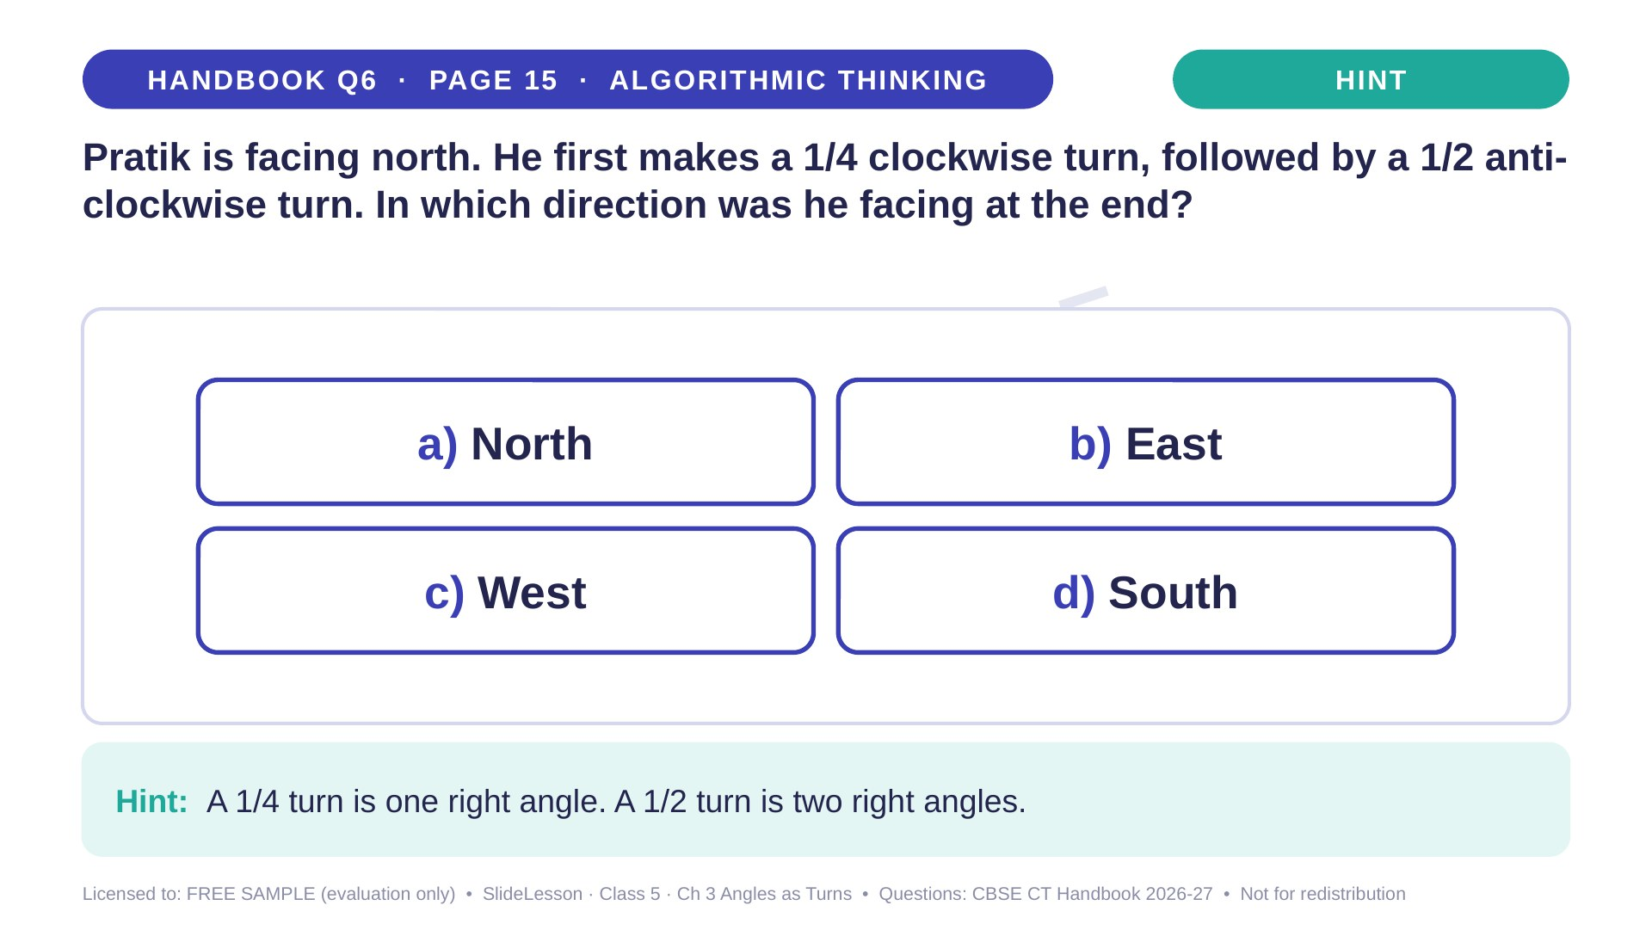
Notes:
Give the hint, then 1 more minute. Ask 2-3 children with DIFFERENT answers to explain their thinking before moving on.
WHILE SOLVING: have children stand and turn, calling out each direction. COMMON MISTAKE: treating a 1/2 turn as one right angle, which gives North. EXTENSION: what about a 3/4 clockwise turn from North? (West)

Slide 40

Notes:
WHILE SOLVING: have children stand and turn, calling out each direction. COMMON MISTAKE: treating a 1/2 turn as one right angle, which gives North. EXTENSION: what about a 3/4 clockwise turn from North? (West)

Slide 41
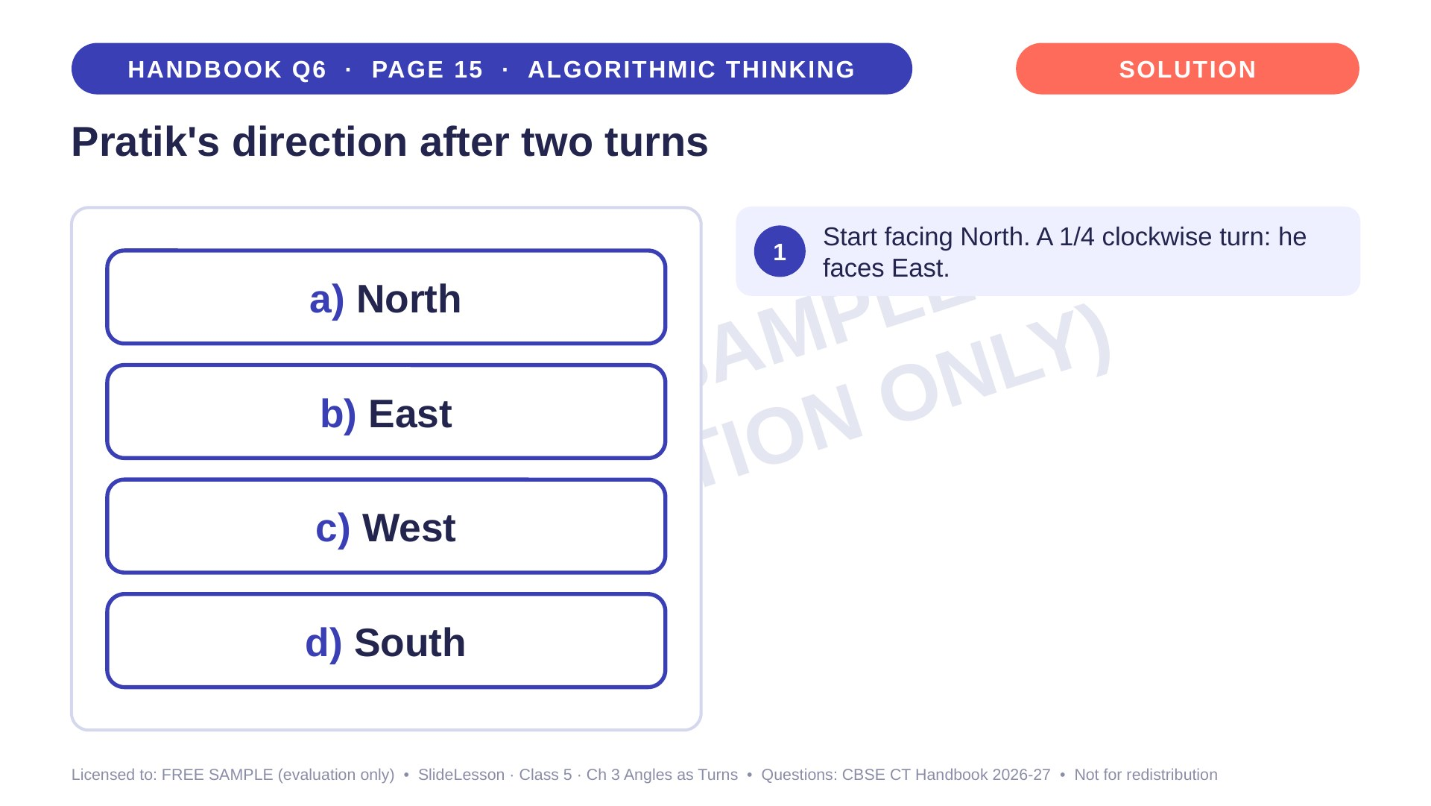
Notes:
Step 1 of 4

Slide 42
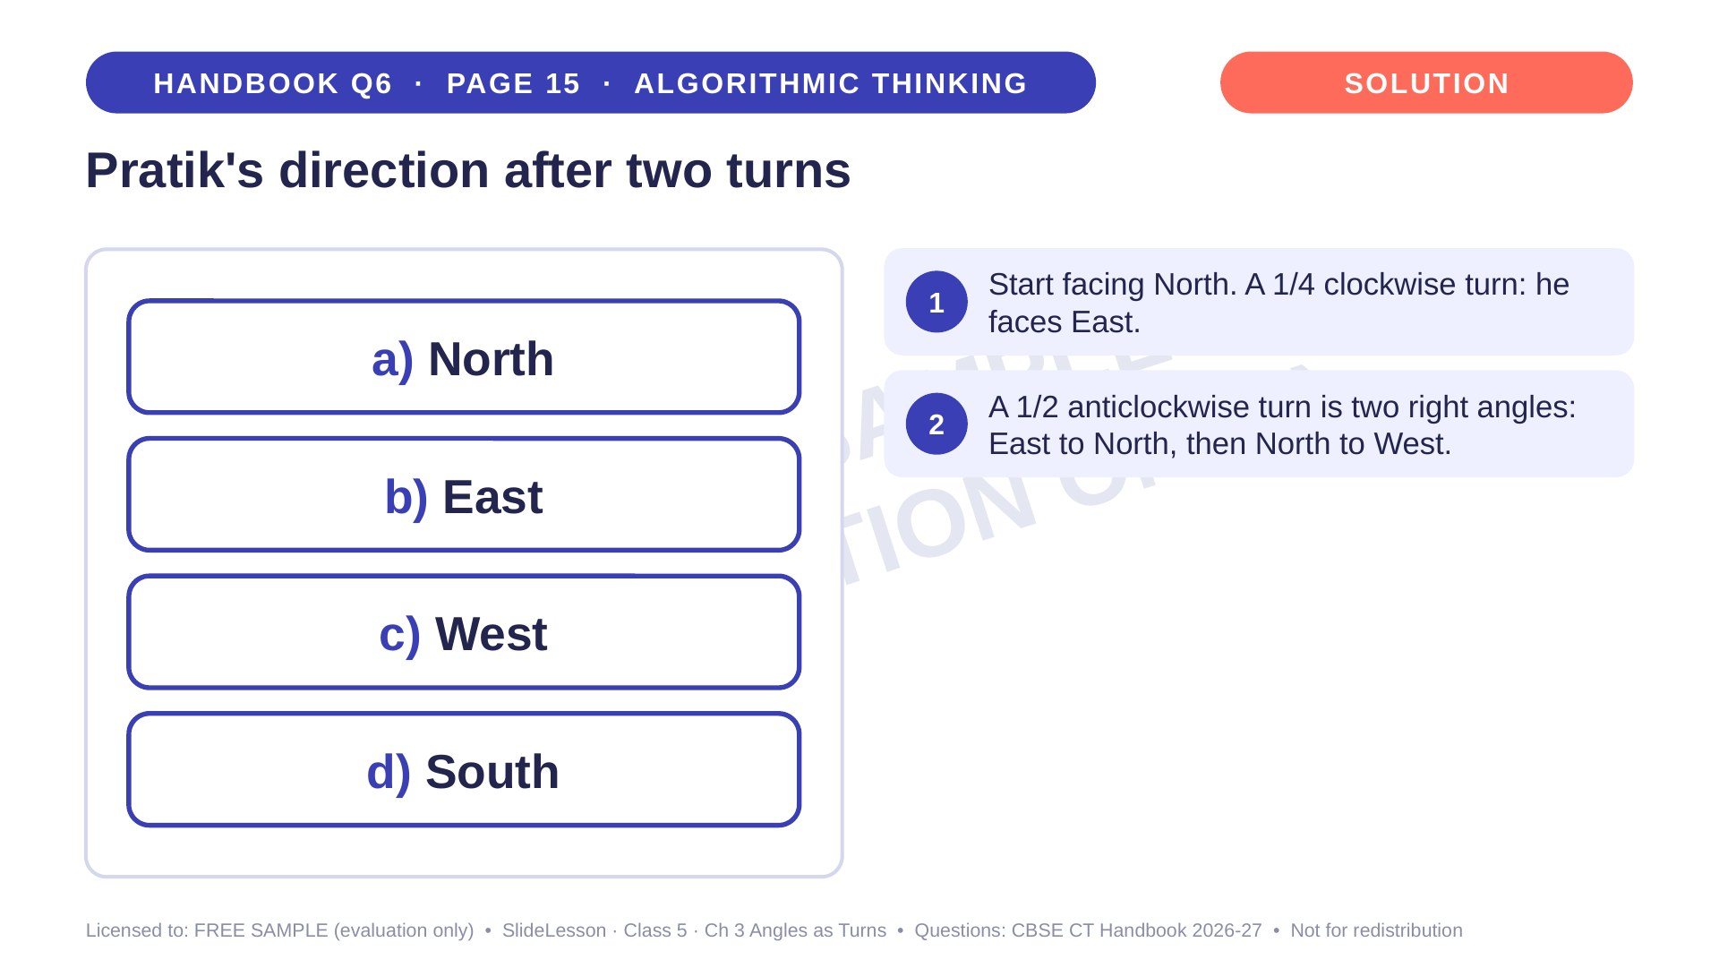
Notes:
Step 2 of 4

Slide 43
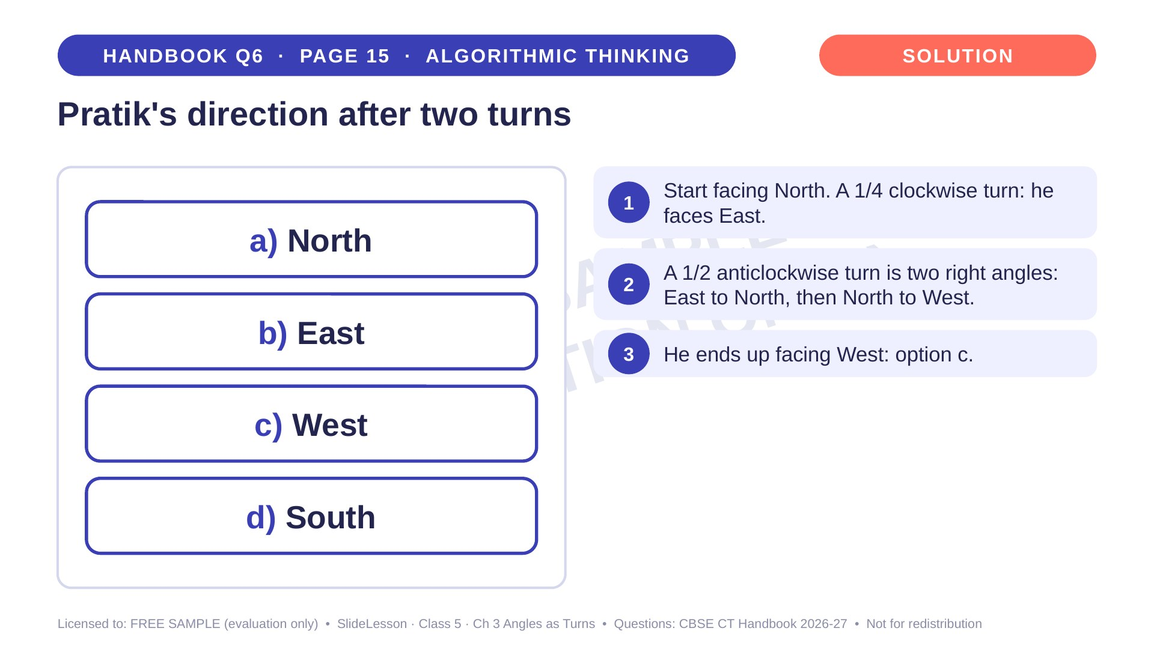
Notes:
Step 3 of 4

Slide 44
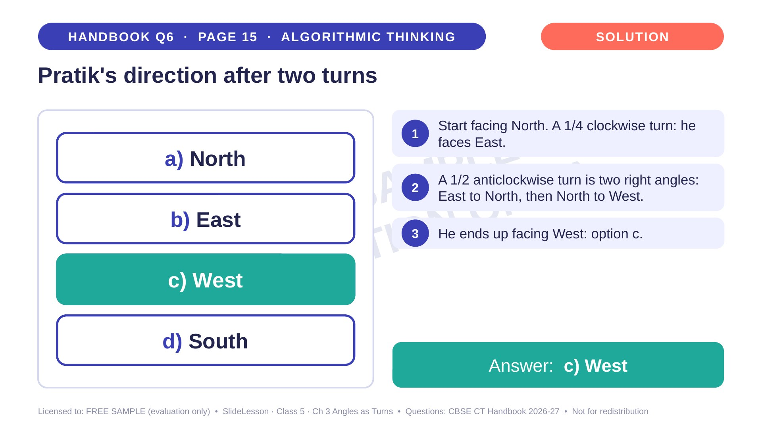
Notes:
Step 4 of 4

Slide 45
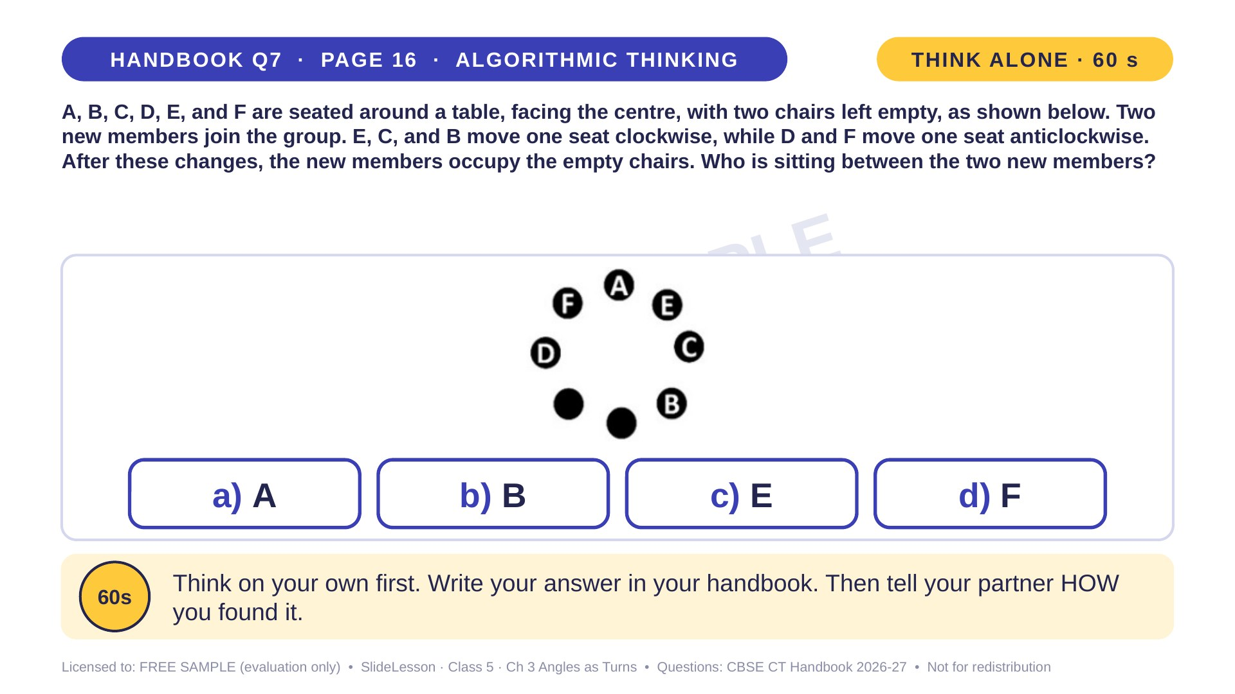
Notes:
WHILE SOLVING: set up 8 chairs in a circle and let children act out the moves. COMMON MISTAKE: moving everyone in the same direction. EXTENSION: who sits opposite A after the moves? (B)
ANSWER (do not tell yet): a) A

Slide 46
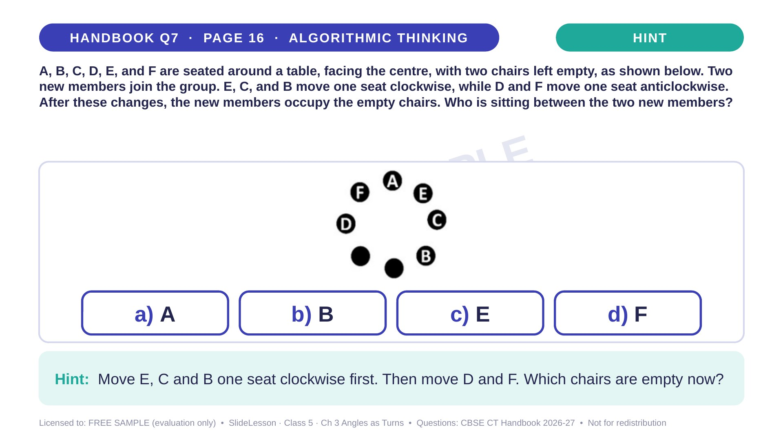
Notes:
Give the hint, then 1 more minute. Ask 2-3 children with DIFFERENT answers to explain their thinking before moving on.
WHILE SOLVING: set up 8 chairs in a circle and let children act out the moves. COMMON MISTAKE: moving everyone in the same direction. EXTENSION: who sits opposite A after the moves? (B)

Slide 47
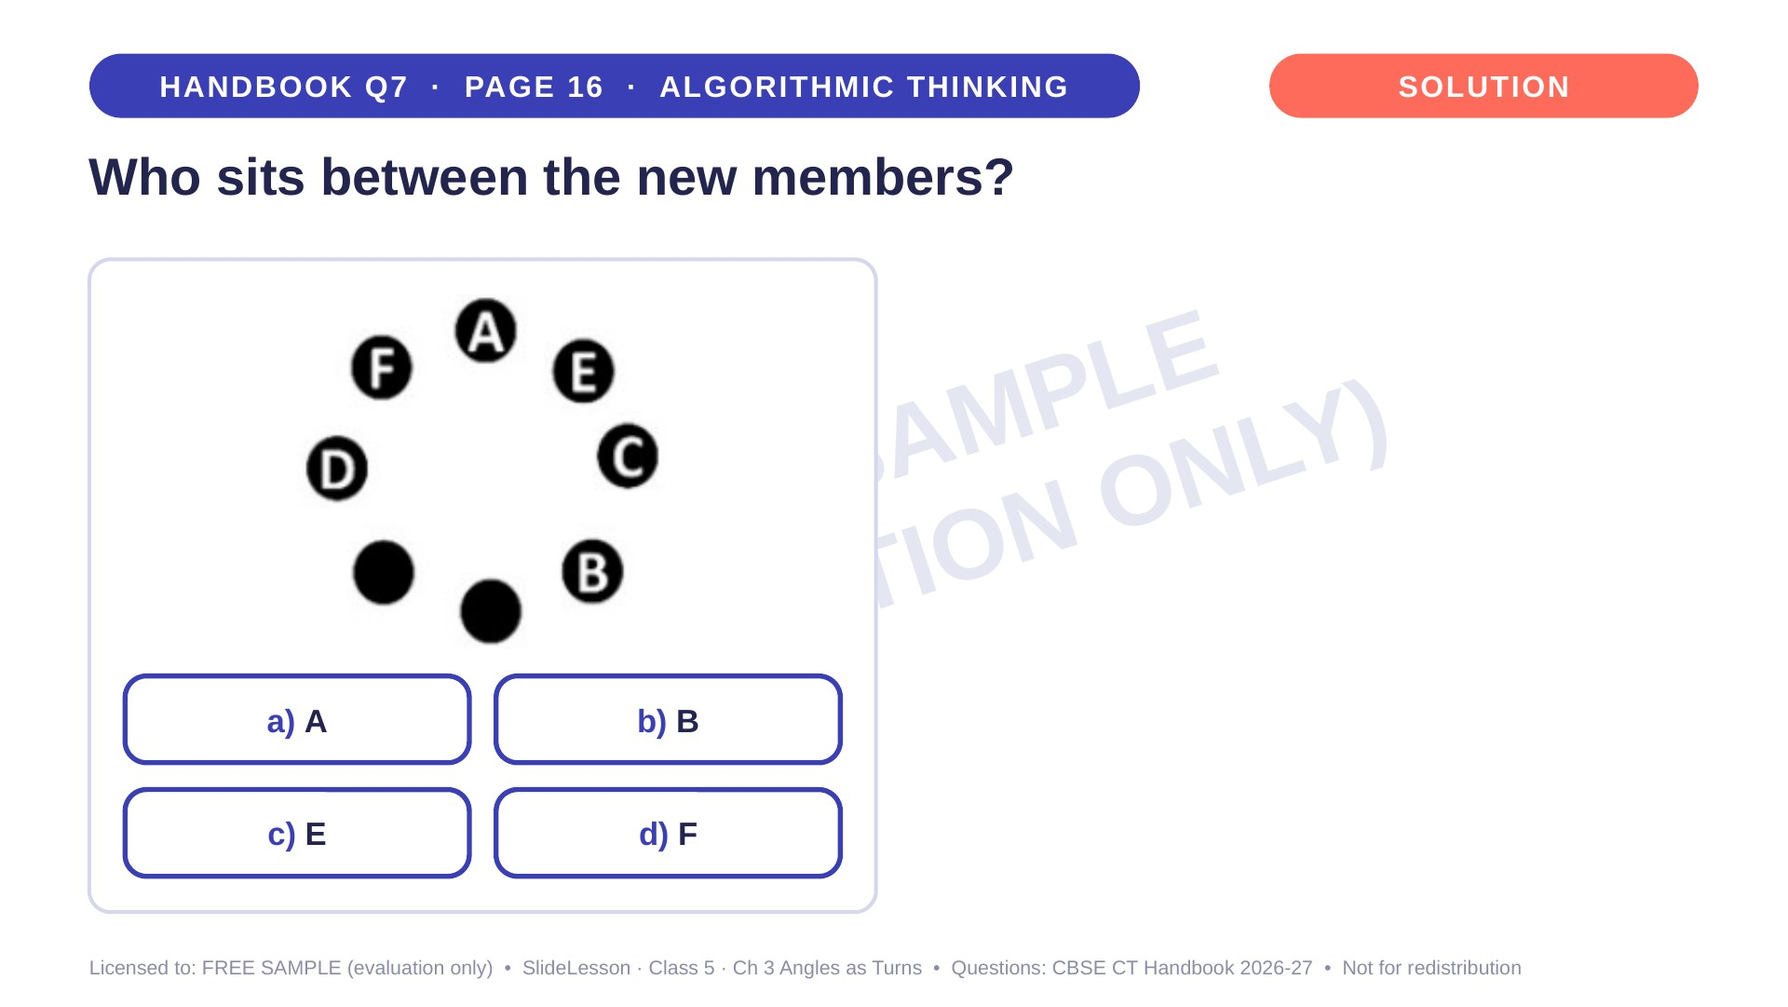
Notes:
WHILE SOLVING: set up 8 chairs in a circle and let children act out the moves. COMMON MISTAKE: moving everyone in the same direction. EXTENSION: who sits opposite A after the moves? (B)

Slide 48
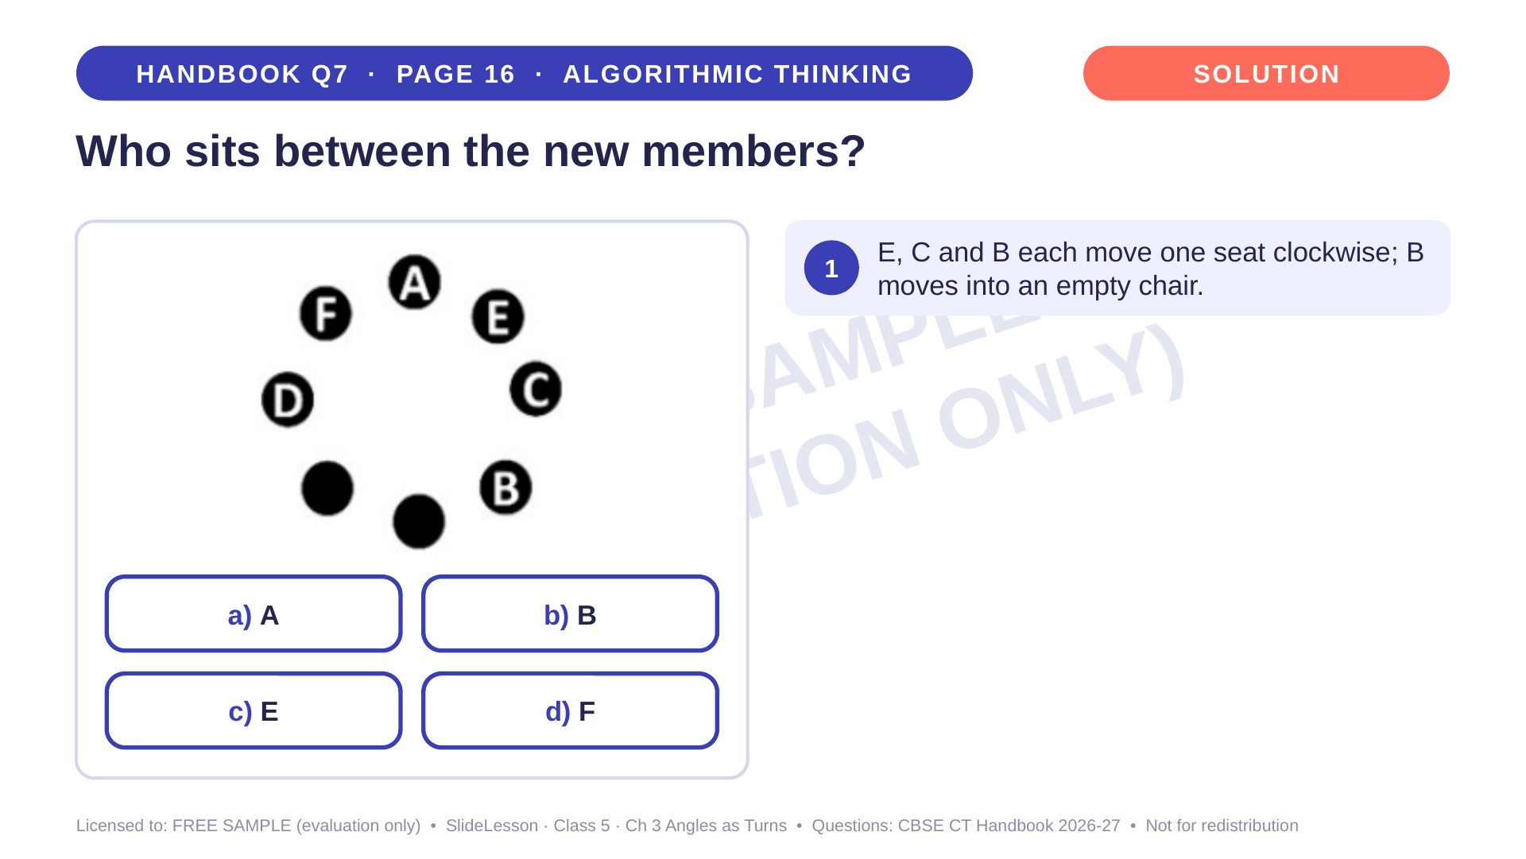
Notes:
Step 1 of 4

Slide 49
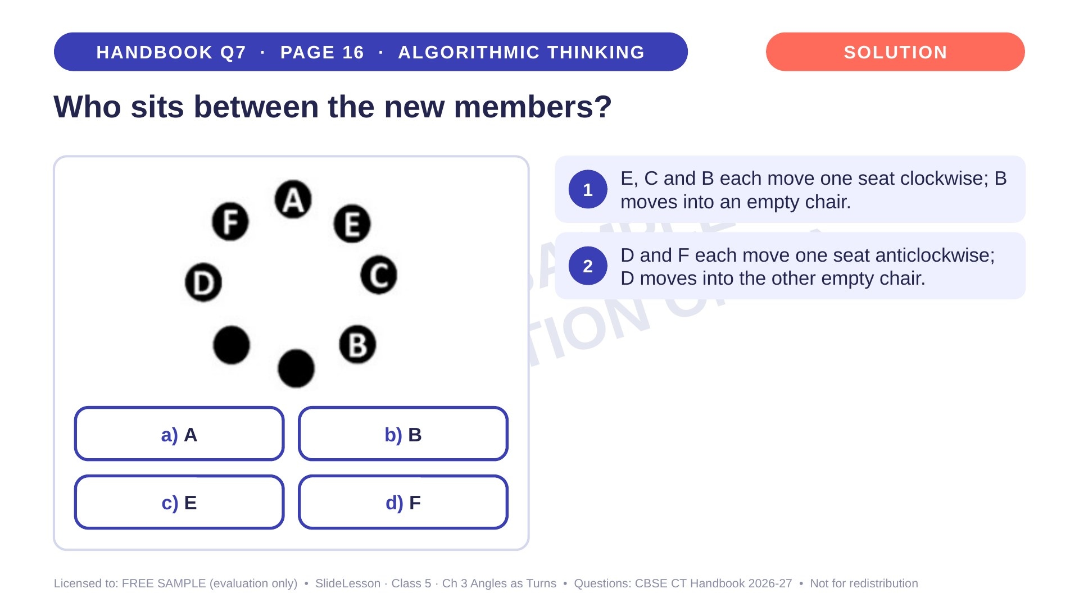
Notes:
Step 2 of 4

Slide 50
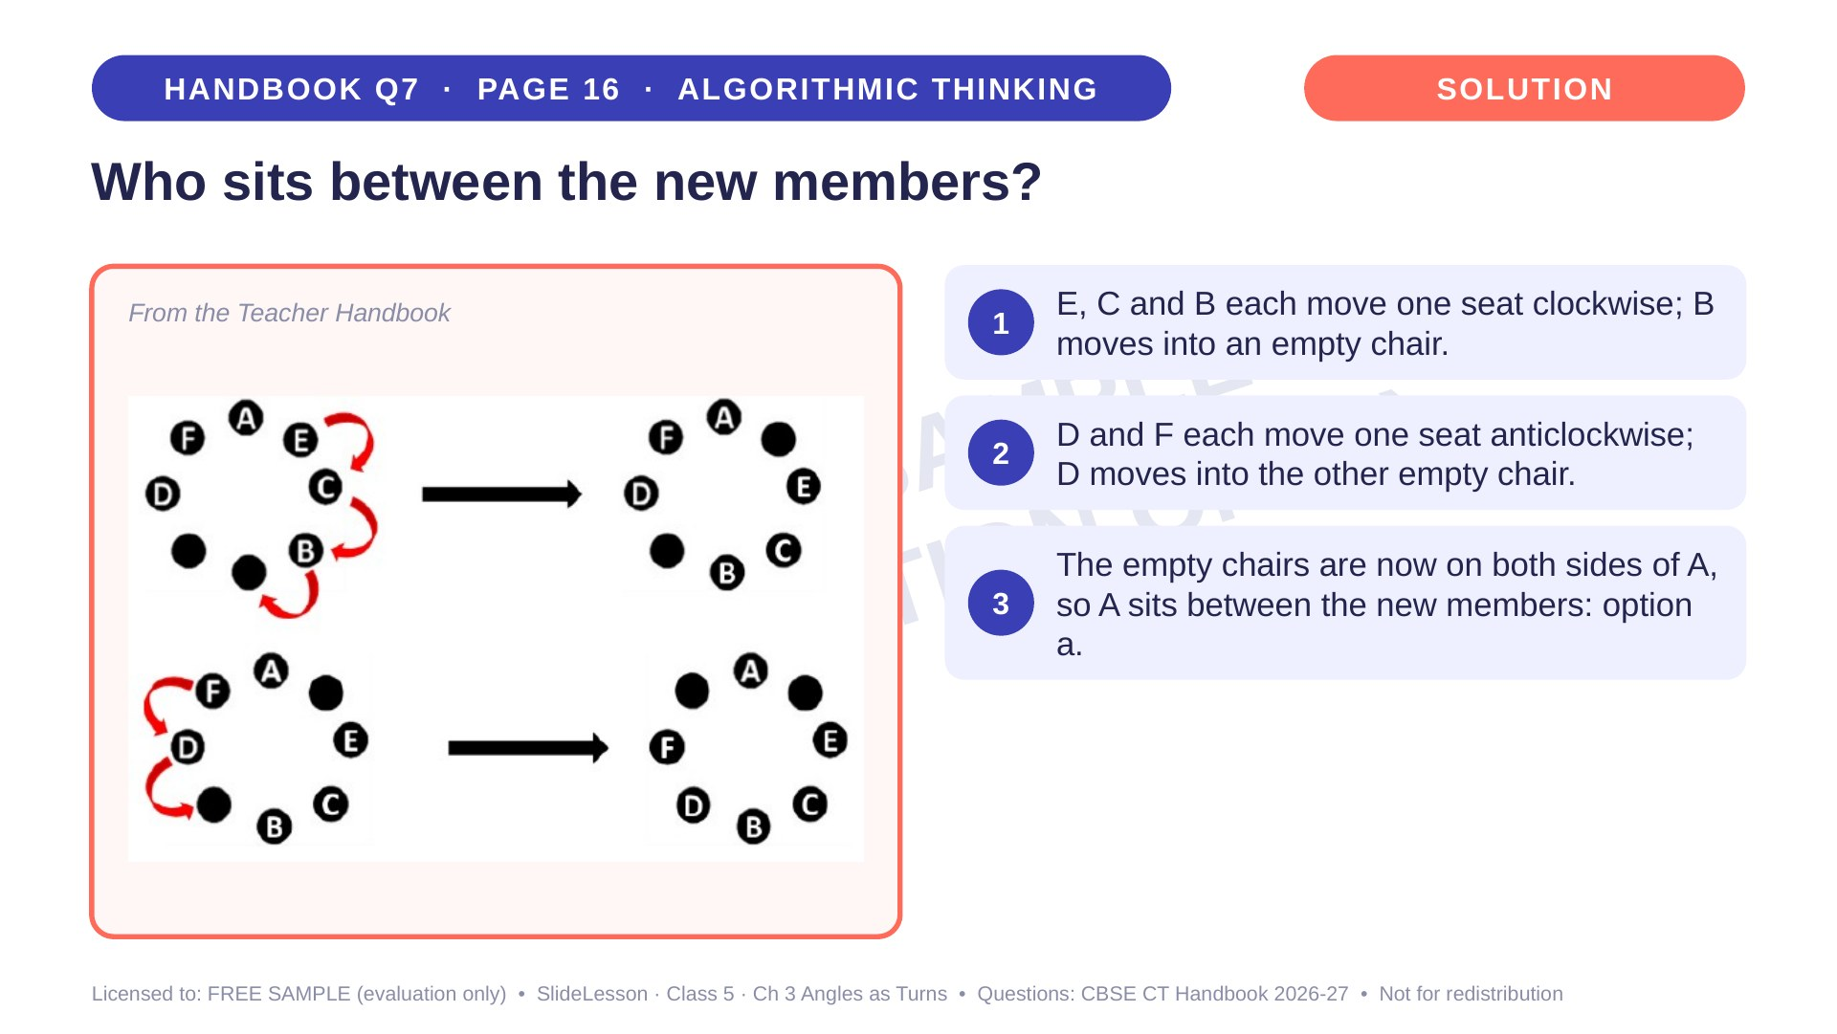
Notes:
Step 3 of 4

Slide 51
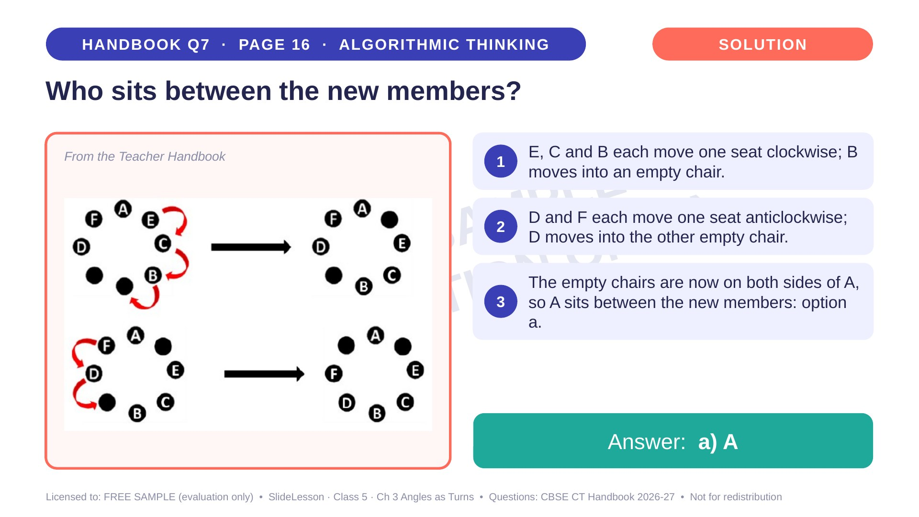
Notes:
Step 4 of 4

Slide 52

Notes:
WHILE SOLVING: two children act as Rohan and Kamini. COMMON MISTAKE: choosing a, which makes both face North. EXTENSION: what single turn makes them face the SAME way? (Kamini a quarter turn anticlockwise)
ANSWER (do not tell yet): b) Kamini taking 1 quarter turn in a clockwise direction

Slide 53

Notes:
Give the hint, then 1 more minute. Ask 2-3 children with DIFFERENT answers to explain their thinking before moving on.
WHILE SOLVING: two children act as Rohan and Kamini. COMMON MISTAKE: choosing a, which makes both face North. EXTENSION: what single turn makes them face the SAME way? (Kamini a quarter turn anticlockwise)

Slide 54

Notes:
WHILE SOLVING: two children act as Rohan and Kamini. COMMON MISTAKE: choosing a, which makes both face North. EXTENSION: what single turn makes them face the SAME way? (Kamini a quarter turn anticlockwise)

Slide 55

Notes:
Step 1 of 4

Slide 56

Notes:
Step 2 of 4

Slide 57

Notes:
Step 3 of 4

Slide 58

Notes:
Step 4 of 4

Slide 59

Notes:
WHILE SOLVING: trace term 3 on paper and physically turn it. COMMON MISTAKE: turning the shape but not the arrow heads. EXTENSION: what would the 5th term look like? (the same as the 1st)
ANSWER (do not tell yet): d

Slide 60

Notes:
Give the hint, then 1 more minute. Ask 2-3 children with DIFFERENT answers to explain their thinking before moving on.
WHILE SOLVING: trace term 3 on paper and physically turn it. COMMON MISTAKE: turning the shape but not the arrow heads. EXTENSION: what would the 5th term look like? (the same as the 1st)

Slide 61

Notes:
WHILE SOLVING: trace term 3 on paper and physically turn it. COMMON MISTAKE: turning the shape but not the arrow heads. EXTENSION: what would the 5th term look like? (the same as the 1st)

Slide 62

Notes:
Step 1 of 4

Slide 63

Notes:
Step 2 of 4

Slide 64

Notes:
Step 3 of 4

Slide 65

Notes:
Step 4 of 4

Slide 66

Notes:
WHILE SOLVING: trace the clockwise path around the square with a finger. COMMON MISTAKE: moving the boxes anticlockwise. EXTENSION: where are they after one more clockwise move? (top-right and top-left)
ANSWER (do not tell yet): d

Slide 67

Notes:
Give the hint, then 1 more minute. Ask 2-3 children with DIFFERENT answers to explain their thinking before moving on.
WHILE SOLVING: trace the clockwise path around the square with a finger. COMMON MISTAKE: moving the boxes anticlockwise. EXTENSION: where are they after one more clockwise move? (top-right and top-left)

Slide 68

Notes:
WHILE SOLVING: trace the clockwise path around the square with a finger. COMMON MISTAKE: moving the boxes anticlockwise. EXTENSION: where are they after one more clockwise move? (top-right and top-left)

Slide 69

Notes:
Step 1 of 4

Slide 70

Notes:
Step 2 of 4

Slide 71

Notes:
Step 3 of 4

Slide 72

Notes:
Step 4 of 4

Slide 73

Notes:
WHILE SOLVING: give children a printed grid and counters to place. COMMON MISTAKE: counting corner-touching blocks as adjacent. EXTENSION: why is 1 block not enough? (no empty block touches all 5 birds)
ANSWER (do not tell yet): a) 2

Slide 74

Notes:
Give the hint, then 1 more minute. Ask 2-3 children with DIFFERENT answers to explain their thinking before moving on.
WHILE SOLVING: give children a printed grid and counters to place. COMMON MISTAKE: counting corner-touching blocks as adjacent. EXTENSION: why is 1 block not enough? (no empty block touches all 5 birds)

Slide 75

Notes:
WHILE SOLVING: give children a printed grid and counters to place. COMMON MISTAKE: counting corner-touching blocks as adjacent. EXTENSION: why is 1 block not enough? (no empty block touches all 5 birds)

Slide 76

Notes:
Step 1 of 4

Slide 77

Notes:
Step 2 of 4

Slide 78

Notes:
Step 3 of 4

Slide 79

Notes:
Step 4 of 4

Slide 80


Slide 81


